Slide 1
2018 Commission on Accreditation Update Leadership
Stephen McCutcheon, PhD – Chair
David Smith, PhD, ABPP – Associate Chair, Program Review
Cindy Juntunen, PhD – Associate Chair, Quality Assurance

Slide 2
Agenda
The APA Commission on Accreditation
Call for Open Seat Nomination
Call for Site Visitors
Current and Future Directions
Public Comment
CoA Website Orientation

Slide 3
The Commission on Accreditation
The APA’s Commission on Accreditation (CoA) accredits programs at the doctoral, internship, and postdoctoral residency levels that prepare individuals in health service psychology.
CoA reviews programs for their consistency with the Standards of Accreditation in Health Service Psychology (SoA). The SoA became effective January 1, 2017.
The CoA accredits approximately 1145 programs preparing individuals in health service psychology.
401 Doctoral Programs (244 Clinical, 75 Counseling, 70 School, & 12 Combined)
612 Internship Programs
132 Postdoctoral Residency Programs (80 Clinical, 27 Neuropsychology, 9 Clinical Health, 7 Clinical Child,6 Rehabilitation, 2 Geropsychology and 1 Forensic)
Notes:
Our scope is granular and specific to each training level, that said, the statement above speaks to the general scope that is consistent across training levels.
Doctoral break-down:
Ph.D 306
Psy.D. 88

Slide 4
The Commission on Accreditation
The CoA is a 32-member body representing a broad array of constituencies.
The CoA is responsible for formulating, promulgating, and implementing accreditation policies, procedures, and criteria for the accreditation of programs in health service psychology.
The CoA meets four times annually to consider policy-related matters and to act on programs seeking accreditation or re-accreditation.
Feb 6-10, 2019 Policy Meeting
April 4-7, 2019 Spring Program Review Meeting
July 18-21, 2019 Summer Program Review Meeting
Oct 17-20, 2019 Fall Program Review Meeting

Slide 5
Call for Site Visitors
The CoA is actively seeking site visitors for all levels of training. Significant need for internship, postdoctoral, as well as generalist site visitors.
Vital role in the accreditation process. Rewarding way to serve the profession of psychology.
The growing diversity of training and program aims has created a greater need for a robust cadre of site visitors to provide effective and appropriate observations.
Upcoming site visitor workshops are listed on the Commission’s website; http://www.apa.org/ed/accreditation/visits/visitors/workshops.aspx. Completers receive 7.5 CE credits.
For more information on how to become a site visitor or be retrained as a site visitor under the SoA, please visit the Office of Program Consultation and Accreditation webpage or contact the office at (202) 336-5979.

Slide 6
Recent Policy Updates
Revised Attestation
AOP Revisions Approved (accreditation effective date, removal of AP)
CVs no longer required in the self-study
Revised site visitor confidentiality agreement

Slide 7
Implementing Regulations of Interest
 | Doctoral | Internship | Postdoctoral
Direct Observation | IR C-14 D | IR C-17 I | IR C-17 P
Profession Wide Competencies | IR C-8 D | IR C-8 I | IR C-9 P
Outcome Data | IR C-18 D | IR C-16 I | IR C-16 P
Trainee Admissions, Support, and Outcome Data |  | IR C-27 I | IR C-23 P
Notes:
Direct Observation: +audio, one time/evaluation, all competencies?
Outcome Data: elements, MLA
Public Comment
Diversity recruitment and retention
Accredit on contingency

Slide 8
Top Reasons Programs Receive Reporting Requirements
Recruitment and Retention
Proximal and Distal Data
Supervision
Sufficient Number of Interns
Substantive Changes

Slide 9
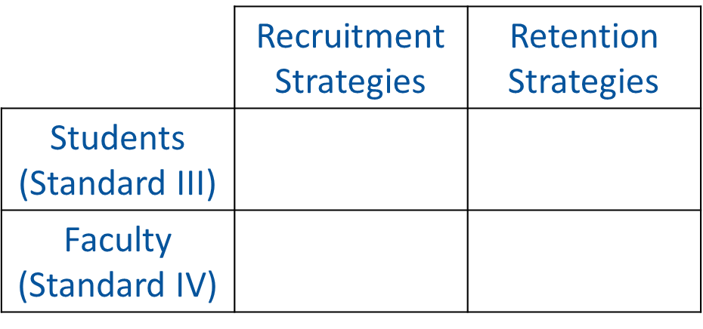
Recruitment and Retention
Reporting Diversity Recruitment and Retention
Refer to IR C-21 D, IR C-19 I or IR C-6 P

Slide 10
Proximal and Distal Data
Proximal: Data demonstrating that MLAs are met for all PWCs and PSCs (if any).
Distal: Data demonstrating achievement of PWCs and PSCs (If any).
Specify MLA and methods of evaluation appropriate to each competency.
Provide outcome data linked to exit criteria and demonstrate all students met MLAs upon completion.
IR C-18 D, IR C-16 I and IR C-16 P

Slide 11
Internship Supervision
At least 4 hours of supervision per week
One or more licensed and appropriately trained psychologists involved in supervisory relationship must conduct 2 hours of individual supervision with intern
Supervisory hours beyond 2 hours of individual supervision must be consistent with definition of supervision
Interns should have access to consultation and supervision during times they are providing clinical services.
Notes:
Standard II.A. Required Profession-Wide Competencies
Supervision
The CoA views supervision as grounded in science and integral to the activities of health service psychology. Supervision involves the mentoring and monitoring of trainees and others in the development of competence and skill in professional practice and the effective evaluation of those skills. Supervisors act as role models and maintain responsibility for the activities they oversee. Trainees are expected to:
Demonstrate knowledge of supervision models and practices.
Apply this knowledge in direct or simulated practice with psychology trainees, or other health professionals. Examples of direct or simulated practice examples of supervision include, but are not limited to, role-played supervision with others, and peer supervision with other trainees.

Slide 12
PostDoc Supervision
At least two hours per week of individual supervision conducted by appropriately trained and licensed doctoral- level psychologists
Supervisor has ongoing supervisory relationship and primary clinical responsibility for cases they supervise
Primary supervisor responsible for oversight and integration of supervision provided by other health professionals
Notes:
Standard II.A. Required Profession-Wide Competencies
Supervision
The CoA views supervision as grounded in science and integral to the activities of health service psychology. Supervision involves the mentoring and monitoring of trainees and others in the development of competence and skill in professional practice and the effective evaluation of those skills. Supervisors act as role models and maintain responsibility for the activities they oversee. Trainees are expected to:
Demonstrate knowledge of supervision models and practices.
Apply this knowledge in direct or simulated practice with psychology trainees, or other health professionals. Examples of direct or simulated practice examples of supervision include, but are not limited to, role-played supervision with others, and peer supervision with other trainees.

Slide 13
Sufficient Number of Interns
The program has at least two interns who are:
Provided appropriate peer interaction, support, and socialization opportunities
Provided socialization and interaction opportunities with professional colleagues that are consistent with training structure
Perceptive of the program’s philosophy, aims, and expected competencies
Officially recognized at the training site with a title or designation such as “psychology intern”

Slide 14
Substantive Changes
The program is to inform the CoA in a timely manner of changes that could alter the program’s quality. This includes notification of any potential substantive changes in the program, such as:
Sequence of experiential training
Changes in practice area or degree conferred
Faculty changes
Program resources
Changes in administration
IR C-27, D IR C-24 I and IR C-20 P

Slide 15
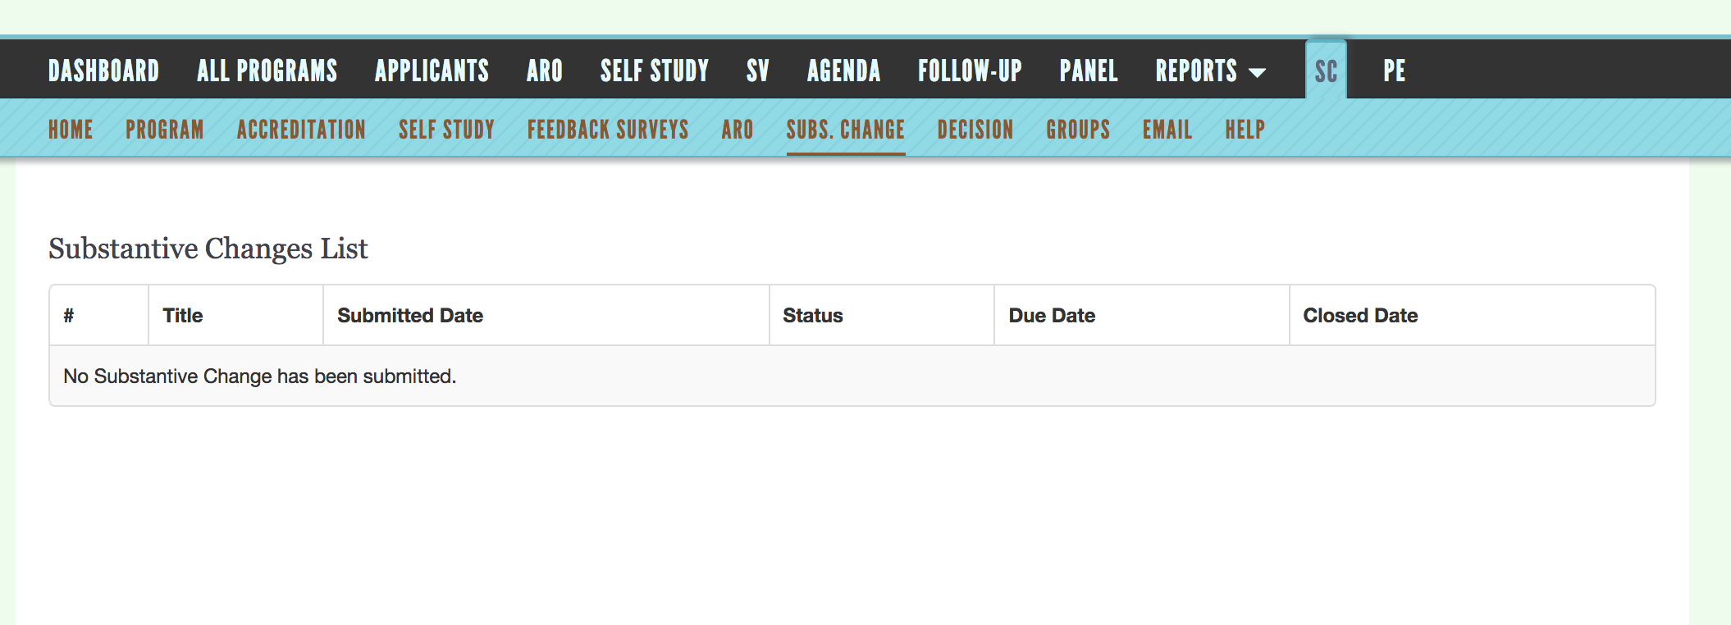
Substantive Changes

Slide 16
Office of Program Consultation & Accreditation Website
Notes:
Highlight that on the landing page of the OPCA website viewers can find the following items of note:
Accreditation search-tool
Listing of applicant, withdrawn, and intent to apply programs
Public Comment System
CoA Update

Slide 17
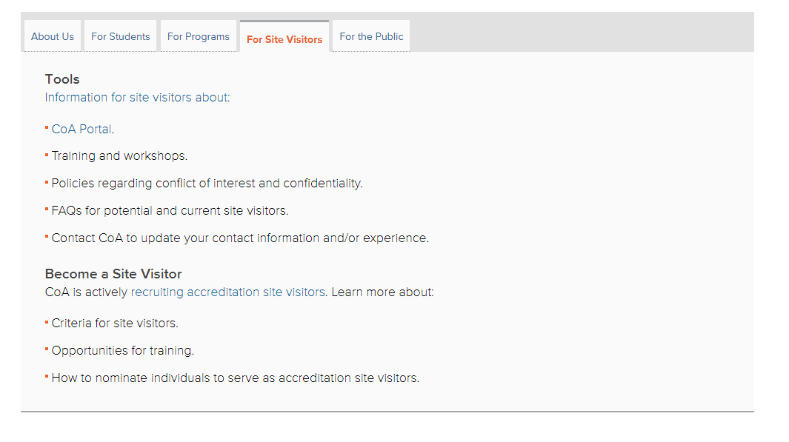
Office of Program Consultation & Accreditation Website
She conceptualizes these difficulties through the lens of epigenetic and intersectional experiences that shape development.

Slide 18
Questions

Slide 19
Office of Program Consultation and Accreditation (OPCA) Contact
Office of Program Consultation and Accreditation 750 First Street, NE Washington, DC 20002-4242
Telephone: (202) 336-5979
apaaccred@apa.org (General Questions) aro@apa.org (Annual Report Online only)
Jacqueline Remondet Wall, PhD | Director, OPCA
Associate Executive Director, Education Directorate
jwall@apa.org

