Slide 1
Navigating Intersectionality in Training & Practice
Justin T. Gibson, Ph.D.
Coordinator of Urgent Services & Staff Psychologist
University of San Diego
jtgibson@sandiego.edu
ACCTA: October 2015

Slide 2
Relevant Background & Outline
Definitions I use – there are various others out there
Stats
Personal Examples
Narratives from others
Training
Questions? Concerns? Comments

Slide 3
What is Intersectionality?
Intersectionality is a process, a continuous one, of examining differential power relations of various identities statuses including but not limited to race/ethnicity, gender, social class, sexual orientation, nation of origin, age, ability status, religion/spirituality, etc.
‘Unjust power relations’ exist between these intersecting identities that introduce complexity that aren’t sufficiently addressed by examining these identities in isolation (Collins, 1998).
Relationships and power dynamics between social locations and processes (e.g., racism, classism, heterosexism, ableism, ageism, sexism) are linked. They can also change over time and be different depending on geographic settings (Hankivsky 2014).
Notes:
3

Slide 4
Student Stories: Mario
Notes:
Introduce the video
Social Justice Advocates at the U.. Intersectionality: Queer People of Color –
Mario Clip: https://youtu.be/JUyn7lKqBa0?t=20m35s
Whole Video:: https://youtu.be/JUyn7lKqBa0

Slide 5
Intersecting Identities

Slide 6
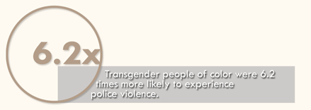
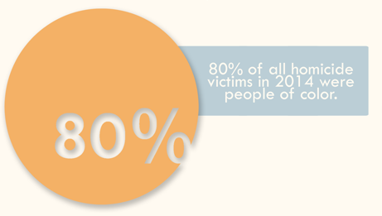
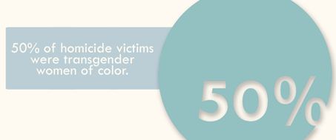
Intersectionality: Why should we care?
Notes:
**National Coalition of Anti-Violence Programs (NCAVP) - 2015

Slide 7
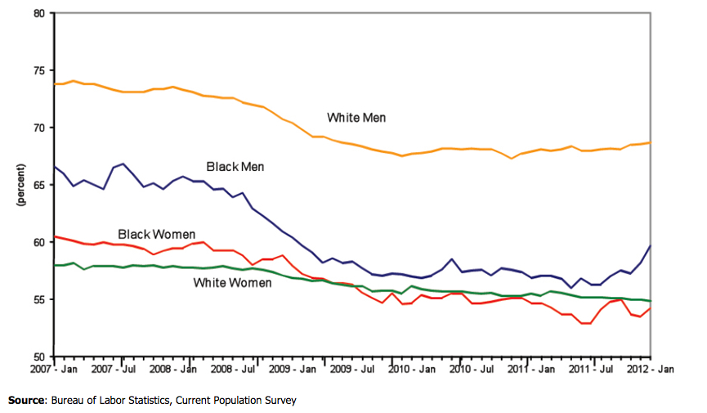
More Stats – Employment & Intersections
Notes:
Most recent data from US Dept of Labor, overall, black men and white men are employed at higher rates than are black women and white women. However, employment rates have fallen much more sharply for men than for women in either racial group since the 2007-2009 recession began.

Slide 8
Flipping the Script – Video 2
Notes:
**Janet Mock – Flipping the Script
https://youtu.be/ISsdSvJhniQ

Slide 9
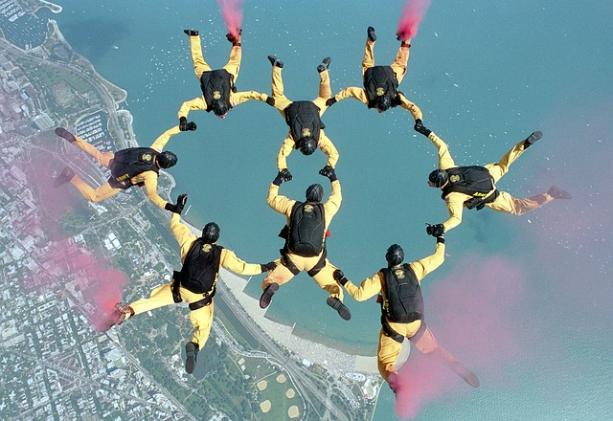
My Philosophy On Training

Slide 10
Location of Self in the Therapy Process & in Training
Leaving the Comfort Zone
Explicit & Implicit Embedded in Identities
Question about Oppression is not “If but How”

Slide 11
My Philosophy On Training Cont …

Slide 12
Training Sequence
5 seminars
2 on Intersectionality
2 on Bias & Blindspots
1 wrap-up
Introduction to the Seminar
Safety, Comfort, Learning Edge, Triggers

Slide 13
http://www.scarleteen.com/tags/sexuality_in_color

Slide 14
First Person Profiles
When you were growing up, the messages I received about my sexual identity were…
When you were growing up, the messages I received about my racial/ethnic background were…
When you were growing up, the messages I received about my gender were….
When you were growing up, the messages/norms that I received around my sexual identity, gender, and racial/ethnic background were…
Sexual behaviors that differ from my own code of ethics or morality make me feel…
My spiritual and/or religious beliefs teach me that sex…
In my culture(s), communicating my sexual needs and desires to my partner(s) is considered….
I communicate my biases and attitudes about sexual identity to my clients by…

Slide 15
Stimulus Questions?
What are the major concerns as you see them in these interviews?
What stuck out about their contexts?
Discuss the differences between the profiles?
Differences in your reactions?
Describe a successful interview that you have conducted with someone different than you?
Describe the differences, how you handled them, and the reason you think they were successful?

Slide 16
Stimulus Questions cont
Describe an interview that was less than successful.
Describe the differences between you and the interviewee, how you handled them and the reason you think the interview was not successful?
Reading the vignettes, what reactions/feelings/thoughts/beliefs were triggered for you?
What potential conflicts do you see between your own beliefs and those of queer students of color? I would feel uncomfortable if a client shared sexual feelings, thoughts, experiences and/or aspects of their identity about… Issues that I feel most comfortable exploring in therapy are…

Slide 17
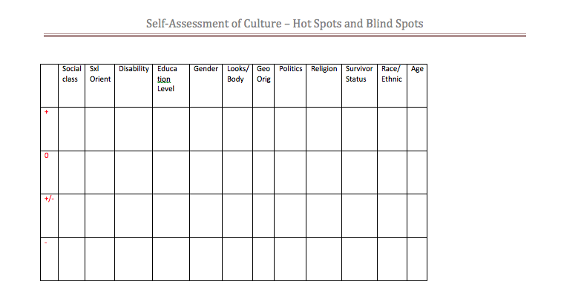
Hot Spots & Blind Spots

Slide 18
Challenges? Triumphs
Emotional Triggers
Conflict Between Interns
Conflict with the Facilitator

Slide 19
Things I’ve Heard Along the Way …
“I feel like I often don’t have anything to contribute to these type of conversations.”
“I feel like you have expectations of me that I can’t me or that I’m disappointing you in someway.”
“I’ve understood my identity as a woman. And then moving to the States, I learned what being Japanese meant here but now I’m starting to see what it means to me and the world around me to be a Japanese woman.”

Slide 20
Things I’ve Heard Along the Way …
“I feel like I was cheated. Because I was told how to be and how to behave, I never got to engage in the exploration growing up and now I feel like I’m missing out.”
“I’ve been keeping this single story in my head, a single story of how I see the world. I’m beginning to see how that limits me in my interactions with people. And I’ve been starting to have contact with my family about how to broaden their perspectives.”

Slide 21
Questions, Feedback, Concerns?

Slide 22
Thank You!!!

Slide 23
Relevant Resources & References
Collins, P.H. (1998). Black feminist thought. New York, NY: Routledge.
Constantine, M.G. (2002). The intersection of Race, Ethnicity, Gender and Social Class in Counseling: Examining Selves in Cultural Contexts. Journal of Multicultural Counseling and Development, 30 (4), 210-215.
Crenshaw, K. (1991). Mapping the Margins: Intersectionality, Identity Politics, and Violence Against Women of Color. Stanford Law Review, 43 (6), 1241-1299.
Hernández, P. & McDowell, T. (2010). Intersectionality, Power, and Relational Safety in Context: Key Concepts in Clinical Supervision. Training and Education in Professional Psychology, 4 (1), 29 – 35.
Dee Watts - Jones, T. (2010). Location of Self: Opening the Door to Dialogue on Intersectionality in the Therapy Process. Family Process, 49 (3), 405-420.
Parks, C.A., Hughes, T.L., & Matthews, A.K. (2004). Race/Ethnicity and Sexual Orientation: Intersecting Identities. Cultural Diversity and Ethnic Minority Psychology, 10 (3), 241-254. Shields, S.A. (2008). Gender: An Intersectionality Perspective. Sex Roles, 59 (5), 301-311.
Pederson, P.B. (2004). 110 Experiences for Multicultural Learning. Washington, DC: American Psychological Association.

Slide 24
Relevant Resources & References
VIDEOS:
Adichie, C.N. (2009, July). The danger of a single story. [Video file]. Retrieved from http://www.ted.com/talks/chimamanda_adichie_the_danger_of_a_single_story?language=en
Fusion. (2014, May 6). Activist Janet Mock Flips the Script on Reporter: Asks Her to Prove Her Womanhood. [Video file]. Retrieved from https://youtu.be/ISsdSvJhniQ
Harvard Foundation. (2014, March 11). Lavern Cox Talks about Intersectionality at Harvard. [Video file]. Retrieved from https://youtu.be/jY3F1pIxHMA
Race Today: A Symposium on Race in America – Brown University. (2015, July 2). Kimberlé Crenshaw, "Race, Gender, Inequality and Intersectionality". [Video file]. Retrieved from https://youtu.be/KNKbGFoYC1Q
Social Justice Advocates at the U. (2014,February 13). Intersectionality: Queer People of Color. [Video file]. Retrieved from https://youtu.be/JUyn7lKqBa0
Tedx Talks. (2013, November 4). Intersectionality matters: Aisha Fukushima. [Video file]. Retrieved from https://youtu.be/Iwp5rQTJi84

