Slide 1
Holding the Hot Potato: Engaging in and Facilitating Difficult Dialogues
Agnes Kwong, Ph.D.
University of Washington
September 11, 2011
Notes:
A little over 10 years ago, I started my masters program at Teachers College at Columbia University. I had just come to New York City from my home town in Edmonton, Alberta Canada, completely overwhelmed by all the people, noise, hustle and bustle of the city. I moved to NYC to be with my partner at the time, and I enrolled in the masters counseling psych program only because I thought it would be a good stepping stone to a forensic clinical psychology doctoral program. Since TC is a program that emphasizes multicultural exploration and counseling, I had no idea what I was in store for. I still remember what I did after one of my first classes in my first weeks there. It was an Introduction to Counseling Theories course and the professor had mentioned race a couple of times. Thinking I knew all there was to know about racial harmony coming from Canada, I went to her office hours (something I never do) and said to her, “I don’t think you should be talking about race. I think that’s why there’s so much racial tension and conflict in the U.S. is because you all talk about it too much.” And that might have been my first challenging dialogue with someone else about race – telling someone, my professor, not to talk about race.
And here I am….

Slide 2
Self-exploration and knowledge of one’s social location in the context of power, privilege, and oppression is critical to social justice training, for both trainers and trainees alike.

Slide 3
Deep, long-lasting, and affective learning occurs when trainees are willing and able to both support and challenge each other. That is, courageous conversations are a cornerstone to multicultural and social justice learning.
Notes:
As we train our trainees to be social justice agents, it becomes vital for trainers and supervisors to provide both formal and informal spaces for trainees to have discussions about the intersections of their identity, their cultural worldview and the ways in which their power, privilege, and oppression impact their work as psychologists-in-training.

Slide 4
It is oppressive to ask trainees to struggle with, endorse, and practice social justice principles without walking the talk ourselves as senior staff and power holders in the system.
Notes:
I would argue that it is oppressive to expect trainees to learn, endorse, and practice social justice principles if trainers - and others who hold power in the system - do not also strive for self-awareness and knowledge as it relates to power, privilege and oppression. This includes the willingness for permanent staff to also be walking the talk and having difficult dialogues themselves.

Slide 5
Authentic dialogues that people have with each other about culture, power, privilege, and oppression are courageous conversations. They are courageous conversations that require intention, care, preparation, time, and attention.
Notes:
It is on this last point that I would like to focus the rest of my time. While there is no right or wrong way to engage in or facilitate difficult dialogues, I believe there are strategies that will promote self-awareness, mutual understanding, and authentic relationships.
So, what I would like to do is
to share with you a framework from which to provide semi-structured spaces for 'hot-topic' dialogues;
outline some strategies and skills for effectively facilitating difficult dialogues; and
highlight the complex challenges and ethical dilemmas inherent for social-justice oriented trainers who are willing to initiate and engage in these dialogues with their trainees.
I also believe this framework and some of the strategies I will be outlining are critical to providing trainees the space and training to be seen, to feel safe enough to take risks to allow themselves the discomfort to learn.

Slide 6
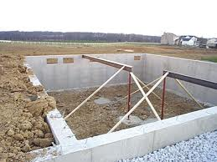
Multicultural Social Justice Seminar Framework
Build a Strong Foundation
Safety and Trust Building
Assess
Notes:
Overarching Framework Several continua to balance:
Didactic and experiential,
content and process throughout,
continual assessment --- need flexibility
[slide] Trust building – most important aspect; it is the foundation

Slide 7
Build, block by block
Multicultural Concepts
Assess, Readjust
Notes:
[slide] Multicultural concepts and experiential exercises
[

Slide 8
Unifying Lens
Social Justice, Anti-Oppression, Power, Privilege
Assess, Readjust
Notes:
slide] Integration of social justice – power, privilege, anti-oppression
House Analogy --- everything is about the foundation. Most time needs to be spent on the foundation, to nurture the relationship and trust amongst trainees and amongst yourself and trainees. Brick by brick, introducing concepts, first the multicultural concepts, and then overlaying it with topics around social justice, power, privilege and anti-oppression.

Slide 9
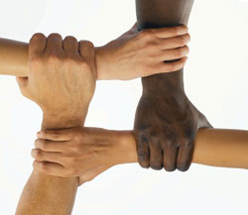
Building Trust and Safety

Slide 10
Safety, Courage, and Comfort in Dialogue

Slide 11
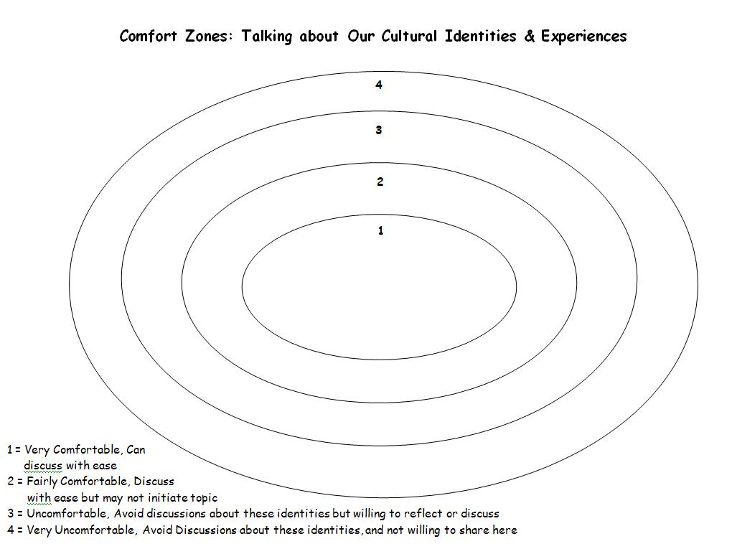

Slide 12
Community Agreements

Slide 14
Identifying Barriers to Authentic Cross-Cultural Dialogue
Notes:
(Concentric Circles Exercise)
Personal, familial, counseling center, university, city,

Slide 15
Multicultural Map
Notes:
Something that is true of most people is that they want to be heard and to be seen before focusing solely on their areas of privilege or power. They want to be seen holistically and the multicultural map is an excellent way for interns to begin the year by feeling seen and connected to each other.
Give examples

Slide 16
Key Facilitation Tips

Slide 17
Attend to both Process and Content

Slide 18
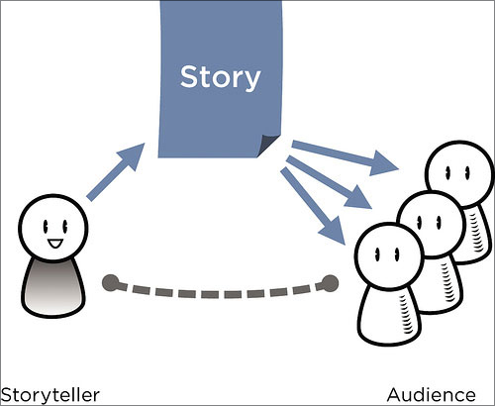
Self as a Pedagogical Tool for Social Justice
Notes:
Use of self as a pedagogical tool (bell hooks, teaching to transgress, be as vulnerable as you expect your trainees to be)

Slide 19
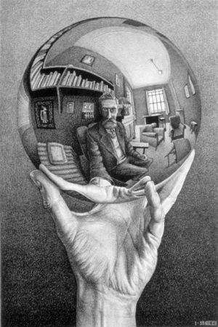
Be aware of your cultural values and the ways in which you hold power and privilege in the room, in the system, and in society at large

Slide 20
Identify and Address the “Ouches” - Microaggressions, Microinvalidations, Microassaults, Impasses
Use developmental frame and strength of the relationships in the room to guide your facilitation
Notes:
Don’t let microaggressions in the seminar pass without them being addressed or queried - These kinds of conversations are universally difficult. They are painful to us all, but as a queer woman of color, it is also true that there is a deep pain that I feel when there is silence, when power and privilege are not acknowledged, when microaggressions are seen but not addressed, when racism is met with silence.

Slide 21
Pacing
Notes:
Pacing --- we know that when we push too hard, depending on where people are at in their identity stage, they may retreat back into holding onto their preconceived notions more firmly or with even more fervor --- it is important to go at a pace where we are riding our trainees’ learning edge

Slide 22
Flexibility
Notes:
where is the group at, what are their unique interests, what are their needs --- some groups like processing more, some less, etc.

Slide 23
Acknowledge & Appreciate
Notes:
Express your appreciation, acknowledge the trainees’ courage --- be a mirror to their strengths

Slide 24
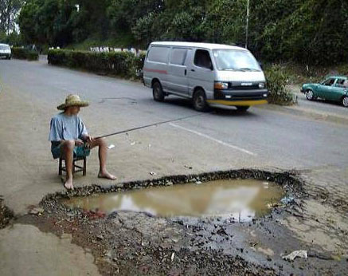
Pitfalls
Notes:
Pitfalls [slide] To use a driving analogy now, this work is full of potholes. Any trainer or trainee willing to take the risk to be vulnerable and to enter into a courageous conversation will come across potholes. And…..some are bigger than others. [slide]
As someone who has been a part of many organizations and who has done some diversity consulting with other groups and organizations, the most common and one of the most harmful pitfalls is to not give enough time for understanding or repair. In a busy system like many counseling centers, there may be enough time to open things up or to show an intensely emotional film like “color of fear,” have folks begin talking and disagreeing with each other, and then stop the process either because there isn’t more time, or because there is fear that things will get worse. And now going back to that nice brick house we built, that’s like tearing down your kitchen wall for a renovation, realizing how messy that gets, and stopping the process and forever saying that it was such a bad idea to tear down that wall.

Slide 25
Common Challenges
Boundaries & Self-Disclosure
Multiple Relationships
Different levels of training & awareness
Time Constraints; breadth vs. depth
Systemic Support
Notes:
Boundaries and Self-Disclosure – How much to share
Multiple relationships – may be supervising one or some of the intern group. Be mindful of them and be
transparent about them. There may also be multiple relationships between interns.
When trainees have very different levels of awareness – going too fast, going too slow --- difficult to pace or be at everyone’s learning edge
Not enough time – depth vs. breadth

