Slide 1
When Things Don’t Go According to Plan: Lessons Learned About Remediation Plans for Trainees
Michael Jay Manalo, Ph.D., HSP-P, NCC
Western Carolina University Counseling & Psychological Services
Association of Counseling Center Training Agencies (ACCTA) Conference 2016
September 13, 2016

Slide 2
At ACCTA last year…

Slide 3
Learning Objectives
Participants will be able to:
Recognize when the implementation of a remediation plan is necessary.
Apply relevant literature, best practices, and “lessons learned” related to remediation plans and managing issues with professional competence.
Utilize case studies and example documentation in the implementation of remediation plans.
Discuss and troubleshoot situations when the remediation plan does not go “according to plan.”
Apply self-care strategies in managing remediation plans.

Slide 4
Self-Reflection – My Remediation Plan

Slide 5
Self-Reflection – Twice in 3 years?

Slide 6
Notes:
Have you ever implemented a remediation plan with a trainee? https://www.polleverywhere.com/multiple_choice_polls/zLTpP9WfVrV7cn8

Slide 7
Notes:
Rate your level of comfort with implementing remediation plans: https://www.polleverywhere.com/multiple_choice_polls/1qHK1Y6BeLcU7oP

Slide 8
Discussion/Activity
What connotations does a remediation plan have?
How do you think it will affect:
Trainee
Supervisors
Other staff
Overall program
You as TD

Slide 9
Why/When do we do remediation plans
To protect the public
To protect the supervisor/training director/program
To protect the trainee
To provide due process (Wester et al., 2008)
Consistent procedures
“A sense programmatic decisions are not being made arbitrarily or personally” (p. 200)

Slide 10
APA Commission on Accreditation G&P (2006)
Domain A (Eligibility), # 6
Program adheres to and makes available to all interested parties formal written policies and procedures that govern… intern performance evaluation, feedback… retention and termination… due process and grievance procedures
Domain E (Intern-Staff Relations), # 4
At the time of admission, the program provides interns with written policies and procedures regarding program requirements and expectations for interns’ performance and continuance in the program and procedures for the termination of interns. Interns receive, at least semiannually, written feedback on the extent to which they are meeting these requirements and performance expectations. The feedback should address the interns’ performance and progress in terms of professional conduct and psychological knowledge, skills, and competencies in the areas of psychological assessment, intervention, and consultation. Such feedback should include: (a) Timely written notification of all problems that have been noted and the opportunity to discuss them; (b) Guidance regarding steps to remediate all problems (if remediable); and (c) Substantive written feedback on the extent to which corrective actions are or are not successful in addressing the issues of concern.

Slide 11
APA Commission on Accreditation SoA (2015)
I.C.1.f (Institutional and Program Context, Program Policies and Procedures, Areas of Coverage)
The program has, adheres to, and makes available to all interested parties formal written policies and procedures that govern interns as they enter and complete the program. These must include policies relevant to… Identification and remediation of insufficient competence and/or problematic behavior, which shall include necessary due process steps of notice, hearing, and appeal.
I.C.3 (Availability of policies and procedures)
At the start of internship, the program must provide interns with written or electronic policies and procedures regarding program and institution requirements, expectations regarding interns’ performance and continuance in the program, and procedures for the termination of interns.

Slide 12
APA Commission on Accreditation SoA (2015)
II.D.1.a (Evaluation of interns’ competencies)
By the end of the internship, each intern must demonstrate achievement of both the profession-wide competencies and any additional competencies required by the program. For each competency, the program must:… Identify the minimum level of achievement or performance required of the intern to demonstrate competency
III.B (Feedback to Interns)
Interns receive, at least semiannually and as the need is observed for it, written feedback on the extent to which they are meeting stipulated performance requirements. Feedback is linked to the program’s expected minimal levels of achievement for profession-wide competencies and any program-specific competencies. Such feedback should include: a. Timely written notification of all problems that have been noted and the opportunity to discuss them; b. Guidance on steps to remediate all problems (if remediable); c. Substantive written feedback on the extent to which corrective actions are or are not successful in addressing the issues of concern; and d. Documentation that the intern evaluation was reviewed and discussed by the intern and the supervisor.

Slide 13
APA Guidelines for Clinical Supervision in Health Service Psychology (2015)
Domain F: Professional Competence Problems
Guideline 1: Supervisors understand and adhere both to the supervisory contract and to program, institutional, and legal policies and procedures related to performance evaluations. Supervisors strive to address performance problems directly
Guideline 2: Supervisors strive to identify potential performance problems promptly, communicate these to the supervisee, and take steps to address these in a timely manner allowing for opportunities to effect change
Guideline 3: Supervisors are competent in developing and implementing plans to remediate performance problems
Guideline 4: Supervisors are mindful of their role as gatekeeper and take appropriate and ethical action in response to supervisee performance problems

Slide 14
Example Description of Insufficient Professional Competence & Inadequate Performance
From WCU CAPS’ Training Manual (2016),
adapted from Intern Training Manual, Counseling and Career Services,
University of California, Santa Barbara

Slide 15
Insufficient Professional Competence and Inadequate Performance
Insufficient professional competence is defined as interference in professional functioning which is reflected in one or more of the following ways:
An inability and/or unwillingness to acquire and integrate professional standards into one's repertoire of professional behavior
An inability to acquire professional skills in order to reach an acceptable level of competency
An inability to control personal stress, psychological dysfunction, and/or excessive emotional reactions which interfere with professional functioning.

Slide 16
Insufficient professional competence is operationalized by evaluation forms and constitutes a rating of 1 out of 7 on any item or documentation of one of the concerns below brought by the individual supervisor to the Training Director. It typically takes the form of one of the following characteristics:
1. The intern does not acknowledge, understand, or address a problem when it is identified.
2. A problem is not merely a reflection of a skill deficit which can be rectified by academic, didactic training, or supervision.
3. The quality of services delivered by the intern is negatively affected to a significant degree.
4. A problem is not restricted to one area of professional functioning.
5. A disproportionate amount of attention by senior staff is required.
6. The intern's behavior does not change as a function of feedback, remediation efforts, and/or time.
7. A problematic behavior has potential for ethical or legal ramifications, if not addressed.
8. The intern's behavior negatively impacts the public view of the agency.
Inadequate performance can be differentiated from insufficient professional competence in that it merely reflects a skill deficit, while insufficient professional competence reflects behavior and/or attitudes that prevent an intern from reaching competent practice. Both are addressed by the remediation procedures.

Slide 17
Review of Literature/Best Practices

Slide 18
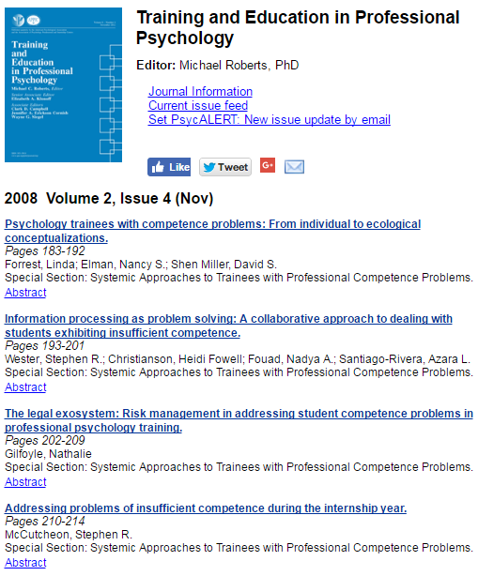

Slide 19
Addressing Problems of Insufficient Competence During the Internship Year (McCutcheon, 2008)
Gate keeping capacity for internship programs
Policy recommendations for licensure eligibility immediately after doctoral degree
Getting away from “Someone else will make the decision if this student is ready for independent practice”

Slide 20
Addressing Problems of Insufficient Competence During the Internship Year (McCutcheon, 2008)
Categories of interns who may exhibit problems of professional competence:
Student with prior history of problems who still exhibits problems on internship
Student with no history of competence problems who is identified as having problems on internship and won’t be able to finish internship successfully
Student who is identified as having problems on internship, but is actually competent (e.g. what if you get it wrong)

Slide 21
The Legal Exosystem: Risk Management in Addressing Student Competence Problems (Gilfoyle, 2008)
Possibility of student challenging remediation plan (lack of due process, breach of contract, defamation, discrimination)
Students have right to due process vs. being dismissed for reasons that are “arbitrary and capricious” (p. 203)
Programs need to demonstrate
They made “considered and fair decision” (p. 202)
Trainee unable to fulfill required clinical work
Trainee was threat to colleagues/clients
They have given notice (in writing) to student regarding problems
They have given student opportunity to respond
They are open in addressing problem

Slide 22
The Legal Exosystem: Risk Management in Addressing Student Competence Problems (Gilfoyle, 2008)
Suggestions:
Keep good records
Link evaluations, warnings, and decisions to established training goals and objectives & essential job duties
Treat similar students in similar manner – don’t have different standards for different students
Have clearly established standards/goals/objectives in training manual, brochures
Let students know expectations upfront (even in application materials/interview process)
Review policies with supervisors – does policy match your actual practice? No “freelancing” (p. 205)
Be careful about how and to whom negative opinions about student are communicated (e.g. only to those who are involved in student evaluation (to avoid defamation)
Let interns know that their evaluation will be shared with home programs

Slide 23
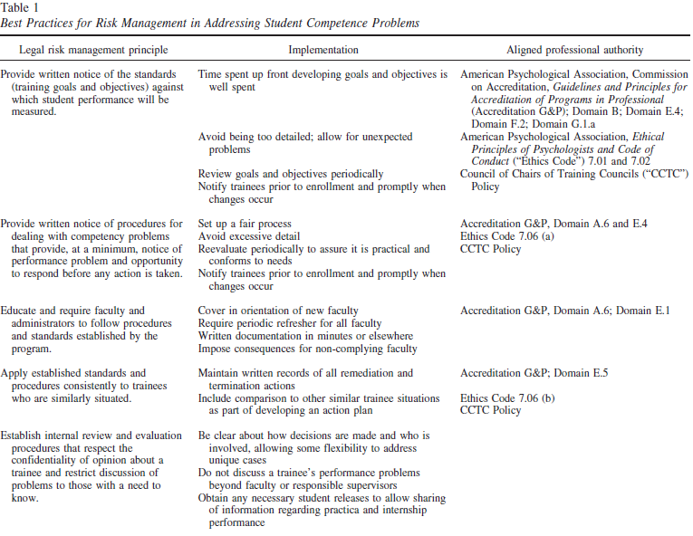

Slide 24
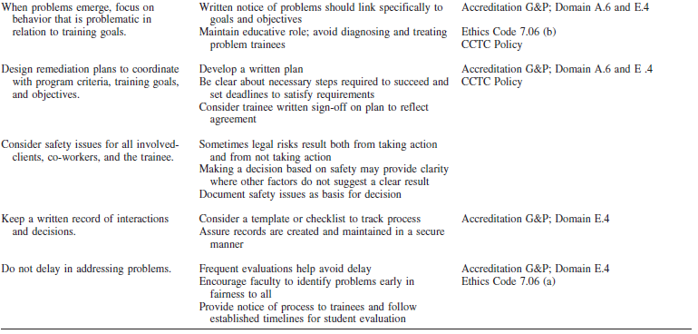

Slide 25
Information Processing As Problem Solving: Collaborative Approach to Student Insufficient Competence (Wester et al., 2008)
Taking a collaborative approach to identifying and addressing competency issues
E.g., not passing the buck or assuming that other supervisors or the Training Director are dealing with the situation
Making decisions about competence in interactive, group format
Having meetings between faculty members and training director and arriving at decision together
Reduces stress to an individual supervisor, and helps protect the student
Draws upon collective experience of the group

Slide 26
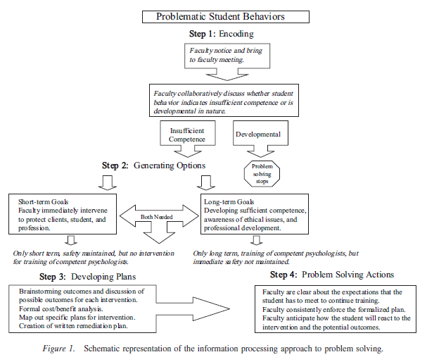

Slide 27
Information Processing As Problem Solving: Collaborative Approach to Student Insufficient Competence (Wester et al., 2008)
Recommendations:
Make decisions collaboratively as a group, not in a vacuum
Understand the impact remediation plans can have on student
Be conscious of potential legal/malpractice implications if problems aren’t addressed
Try to assess and address problems early
Consult with state ethics board, accreditation bodies, legal counsel, human resources

Slide 28
Fundamentals of Clinical Supervision (Bernard & Goodyear, 2009)
Before implementing remediation:
Have extensive discussion with other staff
Review impressions/possible interventions
Judge seriousness of situation
Review documentation to this point
Anticipate how others in system may respond to plan (clients, supervisors, administration, other staff, other interns)

Slide 29
Fundamentals of Clinical Supervision (Bernard & Goodyear, 2009)
In remediation plan, document:
Specific behaviors/areas of functioning that are of concern
Linkages between these behaviors and written evaluations
Ways deficiencies can be addressed
Timeframe during which progress will be reviewed
How trainee’s functioning/responsibilities will change (e.g. having increased supervision)
How trainee can appeal/challenge decision (e.g. due process)

Slide 30
TD’s Perceptions of Faculty Behaviors When Dealing with Trainee Competence Problems (Forrest et al., 2013)
Effective program strategies
Ineffective program strategies
(see next slide)

Slide 31
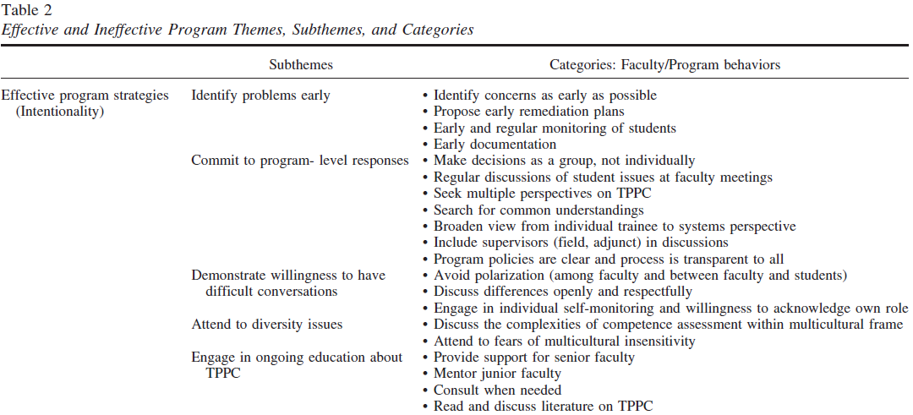

Slide 33
Recognizing, Assessing, and Intervening with Problems of Professional Competence (Kaslow et al., 2007)
Good remediation plans:
Have constructive and educative tone
Identify specific areas of deficit
Tie to benchmarks/expectations that have already been communicated
Give expectations for how improvement can be demonstrated
Tell how you’ll know you’re “done” with the remediation plan
Give timeline

Slide 34
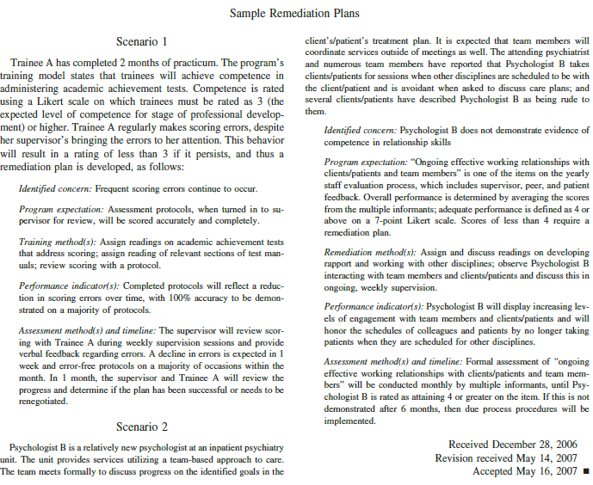

Slide 35
Multicultural/Diversity Issues and Remediation Plans
Power differential
SES differences (e.g. ability to afford professional dress)
Disability issues (e.g. use of term “impaired”) and not diagnosing trainees (Falender et al., 2009)
Language (e.g. language barrier for international students) – (Forrest et al., 2013)
Inadvertent racism, bias, cultural insensitivity towards minority trainees (Forrest et al., 2013)
But also trainees using accusations of racism as means of avoiding looking at their professional competence

Slide 36
Self-Care
(McCutcheon, 2008, p. 211)
“…the professional and personal stresses inherent in a remediation process are profound for faculty and students.”
“…Given this expectation of competence [by the time a student is on internship], both faculty and interns experience understandable confusion and anxiety when a member of the intern class is identified as having problems in performance.”
“The importance of making an accurate assessment in a situation that has some degree of uncertainty or ambiguity makes due process and remediation efforts enormously stressful for most ITD’s [internship training directors] and interns.”

Slide 37
Self-Care
(Wester et al., 2008, p. 197)
“many supervisors feel unprepared to make decisions regarding student incompetence and report feeling fearful as well as guilty about making difficult decisions or intervening in student training”
“…it is sometimes the case that faculty’s gatekeeper role, as well as their ethical imperative to protect the public, necessitates them to dismiss a student who cannot effectively function as a clinician. It is a hard decision to make, and as such its potential consequences to faculty including depression, anxiety, frustration, and indecision need to be taken into account.”

Slide 38
Balancing the self-care needs of…
Trainee
Training Director
Public
Academic Program
Supervisor

Slide 39
Self-Care: Leaving It At The Office (Norcross & Guy, 2007)
Professional Bill of Rights for Psychotherapists (adapted from Jansen and Myers, 1981)
Psychotherapists have the right:
To say “no” to their clients
To not become emotionally involved with their clients
To not like their clients
To actively avoid their patients’ feelings (when appropriate)
To prevent clients from interfering in their personal lives
To disagree with their clients
To be less than technically perfect with their clients
To have limits in their areas of professional expertise
Could this be adapted for supervisors/training directors?

Slide 40
Example Remediation Procedures
From WCU CAPS’ Training Manual (2016),
adapted from Intern Training Manual, Counseling and Career Services,
University of California, Santa Barbara

Slide 41
Remediation Procedures
Remediation procedures are activated when one of the following occurs:
An intern earns a rating of 1 on any evaluation form item
Any member of the senior staff documents a written concern with the Training Director
The latter is likely to happen when a problem or infraction is so serious that it must be reported and addressed prior to the next formal evaluation period. The intern will receive a copy of any formal complaint that is filed. The procedures are initiated by the Training Director informing the Training Committee. If deemed necessary by the Training Director in consultation with CAPS’s administrative team, a remediation committee will be formed. This committee will consist of three senior staff members who are not the intern’s current individual supervisor. Remediation committee members will gather information from collaterals relevant to the issue as well as, the intern and the intern’s current individual supervisor. The remediation committee will discuss the case and arrive by consensus on one of the following remediation actions. When appropriate, remediation committee members will suggest steps to resolve the issue and what conditions indicate successful remediation.

Slide 42
1. No Action
No action will be taken when the remediation committee determines that no problem actually exists.
2. Verbal Warning
A verbal warning will be given to the intern to discontinue the behavior in question. If the behavior is discontinued, no further action will be taken.
3. Written Warning
A written warning to discontinue the behavior in question will be given to the intern and placed in the intern's file. A report of the behavior will likely be made in the next letter to the academic department. The training director may choose not to report the behavior to the department if the problem is satisfactorily addressed by the intern.
4. Probation
Probation is defined as a specific period of time when remediation determined by the committee will be implemented. Remediation may consist of such actions as increased didactic work, increased readings, increased supervision time, participating in therapy outside CAPS, etc. The intern will be closely scrutinized by their supervisors and the training director during this time. Termination of probation is determined by the training committee at a specified future date. If the intern has not adequately changed the behavior by the specified date, probation may be continued or some other sanction may be implemented. The intern will be given a written statement of the probation conditions. Report of the probation will be made to the academic department either immediately or at the next scheduled report time.
5. Temporary Withdrawal of Activity Privileges
If the welfare of the intern or clientele is at risk, the intern will receive a temporary withdrawal of relevant activity privileges to prevent harm. This will occur for a specified time period and be accompanied by remediation activities, both to be specified by the remediation committee. If the intern can demonstrate that the problem has been sufficiently addressed by the end of this period, activities will be resumed and will likely be accompanied by a probation period. The intern will be informed in writing of the conditions of the temporary suspension. This action will be communicated to the academic department immediately.
6. Suspension and Dismissal
Suspension of all activities and dismissal from CAPS may be initiated if it is determined by the committee that imminent harm may occur to the clientele of CAPS if the intern continues or if remediation is found to be unsuccessful. The committee will make a recommendation for suspension and dismissal to the Director of CAPS who will make the final decision. The intern will receive written notice of the dismissal. The academic department will be informed that the intern has not and will not successfully complete the internship.

Slide 43
Documenting Remediation Plans
Documentation of receipt of policies (incl. due process procedures)
Formal written remediation plan
Notes from meetings with supervisors
Notes from meetings with student
Notes from consultations with other professionals
Emails

Slide 44
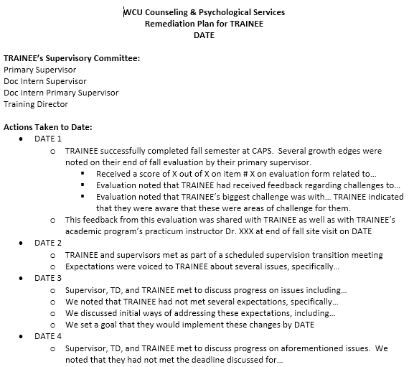
Examples
Sample remediation plan documentation – refer to Word document

Slide 45
Communication re: remediation plans
With the trainee
With supervisors
With the program
What if the trainee’s report conflicts with supervisor’s/program’s report?

Slide 46
Case Examples
Trainee # 1:
No concerns at end of fall semester
Concerns identified in spring semester (hours, professionalism, writing)
Plan: improvements to documentation, time management strategies, seeking out consultation from other team members, additional supervision, improving clinical skills (identifying countertransference, demonstrating greater empathy)
Trainee asked for clarity/examples of problematic behaviors, provided input into changes for remediation plan
Completed plan successfully
Anxiety based? Trainee was able to demonstrate vulnerability and shared feelings of being anxious/overwhelmed

Slide 47
Case Examples
Trainee # 2:
Concerns identified at end of fall semester (documentation, timeliness, professionalism, openness to feedback)
Plan: observation of other clinicians, openness to feedback, hours logs, self-assessment
Avoiding triangulation via ongoing meetings between TD, primary supervisor, doc intern supervisor, doc intern’s primary supervisor
Not signing remediation plan
Self care for doc intern supervisor
Consultation with program
Consultation with other ACCTA members
Did not complete successfully
What emerged later: lack of work experience in professional settings

Slide 48
Overall Recommendations/Troubleshooting
Be sensitive to needs of both trainee and supervisors/staff
“Both and” – promoting fairness to trainee while also holding a line
You don’t have to make decisions completely alone
Consult
With supervisors
With other staff
With ACCTA members
With other resources (e.g. legal counsel)
Use ACCTA as resource
Self-care

Slide 49
References
American Psychological Association. (2006). Guidelines and Principles for Accreditation of Programs in Professional Psychology (G&P). Retrieved from http://www.apa.org/ed/accreditation/about/policies/guiding-principles.pdf
American Psychological Association. (2015). Standards of Accreditation for Health Service Psychology (SoA). Retrieved from https://www.apa.org/ed/accreditation/about/policies/standards-of-accreditation.pdf
American Psychological Association. (2015). Guidelines for clinical supervision in health service psychology. American Psychologist, 70(1), 33-46. doi:10.1037/a0038112
Falender, C. A., Collins, C. J., & Shafranske, E. P. (2009). 'Impairment' and performance issues in clinical supervision: After the 2008 ADA Amendments Act. Training And Education In Professional Psychology, 3(4), 240-249. doi:10.1037/a0017153
Forrest, L., Elman, N. S., Huprich, S. K., Veilleux, J. C., Jacobs, S. C., & Kaslow, N. J. (2013). Training directors' perceptions of faculty behaviors when dealing with trainee competence problems: A mixed method pilot study. Training And Education In Professional Psychology, 7(1), 23-32. doi:10.1037/a0032068
Gilfoyle, N. (2008). The legal exosystem: Risk management in addressing student competence problems in professional psychology training. Training And Education In Professional Psychology, 2(4), 202-209. doi:10.1037/1931-3918.2.4.202
Bernard, J. M., & Goodyear, R. K. (2009). Fundamentals of clinical supervision (4th ed.). Upper Saddle River, NJ: Pearson Education.
Jacobs, S. C., Huprich, S. K., Grus, C. L., Cage, E. A., Elman, N. S., Forrest, L., & ... Kaslow, N. J. (2011). Trainees with professional competency problems: Preparing trainers for difficult but necessary conversations. Training And Education In Professional Psychology, 5(3), 175-184. doi:10.1037/a0024656
Kaslow, N. J., Rubin, N. J., Forrest, L., Elman, N. S., Van Horne, B. A., Jacobs, S. C., & ... Thorn, B. E. (2007). Recognizing, assessing, and intervening with problems of professional competence. Professional Psychology: Research And Practice, 38(5), 479-492. doi:10.1037/0735-7028.38.5.479
McCutcheon, S. R. (2008). Addressing problems of insufficient competence during the internship year. Training And Education In Professional Psychology, 2(4), 210-214. doi:10.1037/a0013535
Norcross, J. C., & Guy Jr., J. D. (2007). Leaving it at the office: A guide to psychotherapist self-care. New York, NY: The Guilford Press.
Wester, S. R., Christianson, H. F., Fouad, N. A., & Santiago-Rivera, A. L. (2008). Information processing as problem solving: A collaborative approach to dealing with students exhibiting insufficient competence. Training And Education In Prssional Psychology, 2(4), 193-201. doi:10.1037/1931-3918.2.4.193

Slide 50
Questions

