Slide 1
The Fair Labor Standards Act
Its impact on internship programs
Karen M. Taylor, Ph.D.
ohio State University
and
Joyce Illfelder-kaye, Ph.D
Penn State University

Slide 2
Introduction
Introductions: Topic and Presenters
The Problem- Joyce
Historical Perspective- Joyce
APA Guidance- Joyce
ACCTA Survey and Results- Karen
Implications and Next Steps- Karen

Slide 3
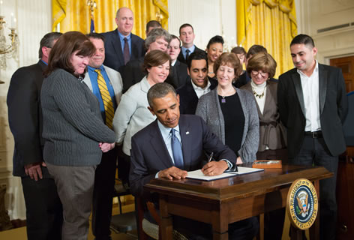
The Problem
Sometimes a good thing is also a complicated thing….

Slide 4
Final Rule: Overtime Defining and Delimiting the Exemptions for Executive, Administrative, Professional, Outside Sales and Computer Employees under the Fair Labor Standards Act
On May 18, 2016, President Obama and Secretary Perez announced the publication of the Department of Labor’s final rule updating the overtime regulations, which will automatically extend overtime pay protections to over 4 million workers within the first year of implementation. This long-awaited update will result in a meaningful boost to many workers’ wallets, and will go a long way toward realizing President Obama’s commitment to ensuring every worker is compensated fairly for their hard work.
In 2014, President Obama signed a Presidential Memorandum directing the Department to update the regulations defining which white collar workers are protected by the FLSA's minimum wage and overtime standards. Consistent with the President's goal of ensuring workers are paid a fair day's pay for a hard day's work, the memorandum instructed the Department to look for ways to modernize and simplify the regulations while ensuring that the FLSA's intended overtime protections are fully implemented.
The Department published a Notice of Proposed Rulemaking (NPRM) in the Federal Register on July 6, 2015 (80 FR 38515) and invited interested parties to submit written comments on the proposed rule at www.regulations.gov by September 4, 2015. The Department received over 270,000 comments in response to the NPRM from a variety of interested stakeholders. The feedback the Department received helped shape the Final Rule.

Slide 5
Implications of this legislation
The minimum salary for employees who do not receive overtime pay has been raised from $23,660 to $47, 476 annually.
Questions have been raised as to whether psychology interns are exempt from this requirement for overtime pay and the answers are not clear

Slide 6
What does “exempt” mean?
Exempt can mean several things…
For some sites interns are not in an employee category at their university- they get a stipend, not a salary and do not get regular university employee benefits- they are not considered employees by the institution and in this sense “exempt” from this legislation.

Slide 7
For some sites interns are considered employees. They are in positions that are controlled by their Human Resources Departments, they are getting salaries and benefits that other employees get. They might be considered “exempt employees” under the terms of the statute because they meet certain requirements and therefore exempt from the requirement for overtime pay

Slide 8
Finally some might be using the term exempt because the person already has a salary over the minimum of $47, 476 annually or fits within the exceptions in the law for medical residents and some others.
We are not aware of any counseling centers paying a stipend this high.

Slide 9
Historical Perspective
In preparing for this presentation I searched my own archives and I did a similar presentation with Mollie Hermann at ACCTA in Jacksonville in 2004 when the minimum was set at $23,660 and intern stipends were generally about $18,000 at the time.
Reviewed folder of material both in electronic file and paper file from 2004-present.
Reviewed ACCTA and APPIC listserv comments on this topic.

Slide 10
APA Guidance
Why is APA not advocating to have psychology included in the law?
Medicine was at the table a long time ago…
Currently there is not a sense that Congress would change the law and the law would need to change to explicitly include psychology
Currently there is hesitance to go to the Department of Labor and ask for a ruling on this because if the ruling was that psychology was not to be included in the same exemptions that medicine is included in then programs that have made a case for it could no longer do so.

Slide 11
Current Guidance from APA
According to DOL, an intern will not be considered an employee subject to the FLSA if the following 6 factors are met:
The training or internship, even though it includes actual operation of the facilities of the employer, is similar to that which would be given in a vocational school.
The training is for the benefit of the interns.
The interns do not displace regular employees, but work under close observation
The employer that provides the training or internship derives no immediate advantage from the activities of the interns, and on occasion the employer’s operation may actually be impeded
The interns are not necessarily entitled to a job at the conclusion of the training period, and
The employer and the interns understand that they are not entitled to wages for the time spent in training or the internship.
They note that interpretation of these factors in any given situation requires careful, individualized analysis

Slide 12
APA Employment Consultant’s Opinion
In addition to the previous 6 part test there is a “primary beneficiary test” used by most courts..
The DOL has made it clear it will scrutinize whether the internship is truly for the predominant benefit of the intern, as opposed to providing a source of relatively inexpensive productive labor for the employer.
http://www.appic.org/Portals/0/downloads/DepartmentOfLaborArticle.pdf

Slide 13
A key factor in this analysis is whether the internship program is part of a degree program
This is a difference between internships and post-docs….
APA is clear that a case can be made but they are not assuring sites that one size will fit all and are clear that sites need to speak with their HR Dept. and legal counsel.

Slide 14
ACCTA SURVEY
10 Item Survey
Sent to ACCTA listserv: August 22nd
Follow-up sent: August 23rd w/ comment regarding
item response problem
Second follow-up sent: August 29th
Survey closed: September 5th
^{N=77}

Slide 15
ACCTA SURVEY
Q1. Have you or your university already determined whether your psychology interns will be considered exempt (from over-time pay) effective Dec. 1, 2016?
Answered: 77
Skipped: 0

Slide 16
ACCTA SURVEY

Slide 17
ACCTA SURVEY

Slide 18
ACCTA SURVEY
Other (please specify) Responses 3.90% 3
We are hearing that it is likely that they will be considered exempt, but I’ve not heard an official decision.
Our interns are already classified as non-exempt employees, which will not be changing to my knowledge. We have not discussed their status with respect to the FLSA specifically, but I presume we will continue paying them overtime for working more than 8 hours/day, per our university policies.
Our consortium head deals with those details, not a direct concern for us.

Slide 19
ACCTA SURVEY
Q2. If your university has decided that interns are EXEMPT, which of the following apply? (Please check all that apply)
Answered: 29
Skipped: 48

Slide 20
ACCTA SURVEY
Our Salary has been increased to over $47,000
Interns are not considered employees at my institution
Our HR Dept. determined that even though they have been considered employees, there was an appropriate rationale to consider them exempt
Other (Please specify)

Slide 21
ACCTA SURVEY

Slide 22
ACCTA SURVEY
Other (please specify) Responses 24.14% 7
Not decided 1
Not decided; awaiting input from HR 1
Non-exempt 3
Employees but only for benefits; 1
otherwise students completing internship for
their education
Interns considered graduate students 1

Slide 23
ACCTA SURVEY
Q3. If you provided a rationale to your HR Department, please indicate which rationale best fits for your internship. (Please check all that apply.)
Answered: 42
Skipped: 35

Slide 24
ACCTA SURVEY
The internship is an academic requirement necessary for completion of the doctoral degree
Interns are still currently enrolled in a doctoral program
Interns are classified as staff in order to provide them with benefits, but in many ways are not employees
Interns are not displacing other staff
Interns are working under the supervision of staff, not independently
Other (Please specify)

Slide 25
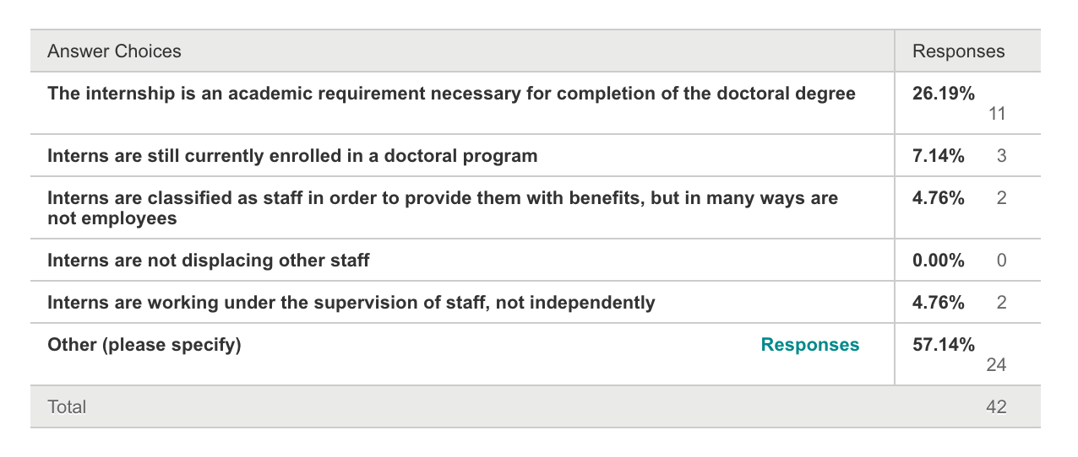
ACCTA SURVEY
1
2
3
4
5

Slide 26
ACCTA SURVEY
Other (please specify) Responses 57.14% 24
Response Endorsement
1 and 2 5
2 1
1, 2, 5 5
1 and 5 1
1, 2, 3, 4 1
All of the above 5
N/A, non-exempt 2
Focus of interns more about training 1
than clinical work

Slide 27
ACCTA SURVEY
Q4. What was the process of determination for the status of your interns?
Answered: 65
Skipped: 12

Slide 28
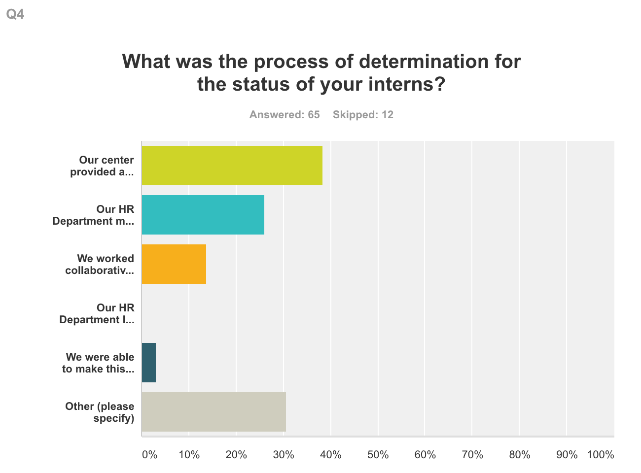
ACCTA SURVEY
Our center provided a rationale to the HR Department who took it under consideration
Our HR Department made their own determination without input from our center
We worked collaboratively in consultation with our HR Department
Our HR Department left the decision to us even though interns are employees
We were able to make this determination as a center since our interns are not in an employment status
Other (please specify)

Slide 29
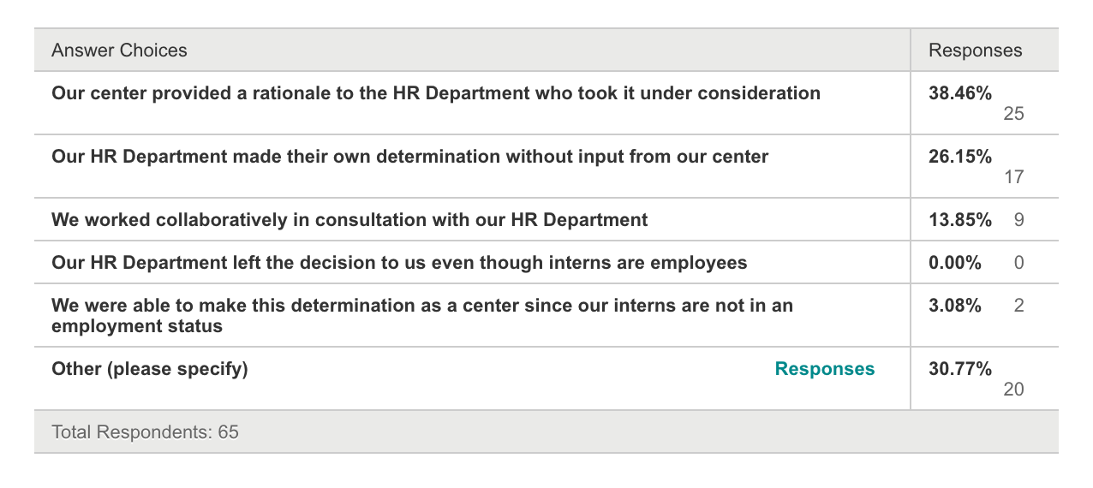
ACCTA SURVEY

Slide 30
ACCTA SURVEY
Other (please specify) Responses 30.77% 20
Majority of comments indicated that the HR Department was making the decision

Slide 31
ACCTA SURVEY
Q5. If you have determined that your interns will be non-exempt on Dec. 1, 2016, how are you planning to maintain a 40 hour work week? (Please check all that apply.)
Answered: 43
Skipped: 34

Slide 32
ACCTA SURVEY
We are reducing the number of clinical hours interns will be expected to carry
We are eliminating any crisis coverage too close to the end of the day
We are eliminating offering any dissertation hours as part of their work week
We are eliminating professional development time as part of their work week
We are creating an overtime fund to pay for a limited number of overtime hours
We are reducing the number of reading we expect interns to read for any seminars
We are adding more notes and record keeping time
Other (please specify)

Slide 33
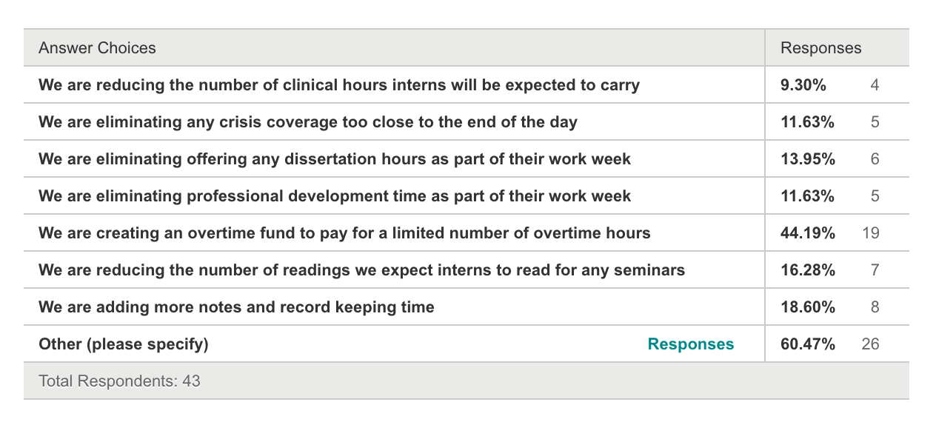
ACCTA SURVEY

Slide 34
ACCTA SURVEY
Other (please specify) Responses 60.74% 26
Reducing crisis coverage
outreach*
seminars
testing
Closely monitor time to keep to 40 hrs.
Shifting groups to earlier in the day
Use of comp time, flex time, over time pay

Slide 35
ACCTA SURVEY
Q6. If you interns will be NON-EXEMPT, how will you track the interns hours?
Answered: 48
Skipped: 29

Slide 36
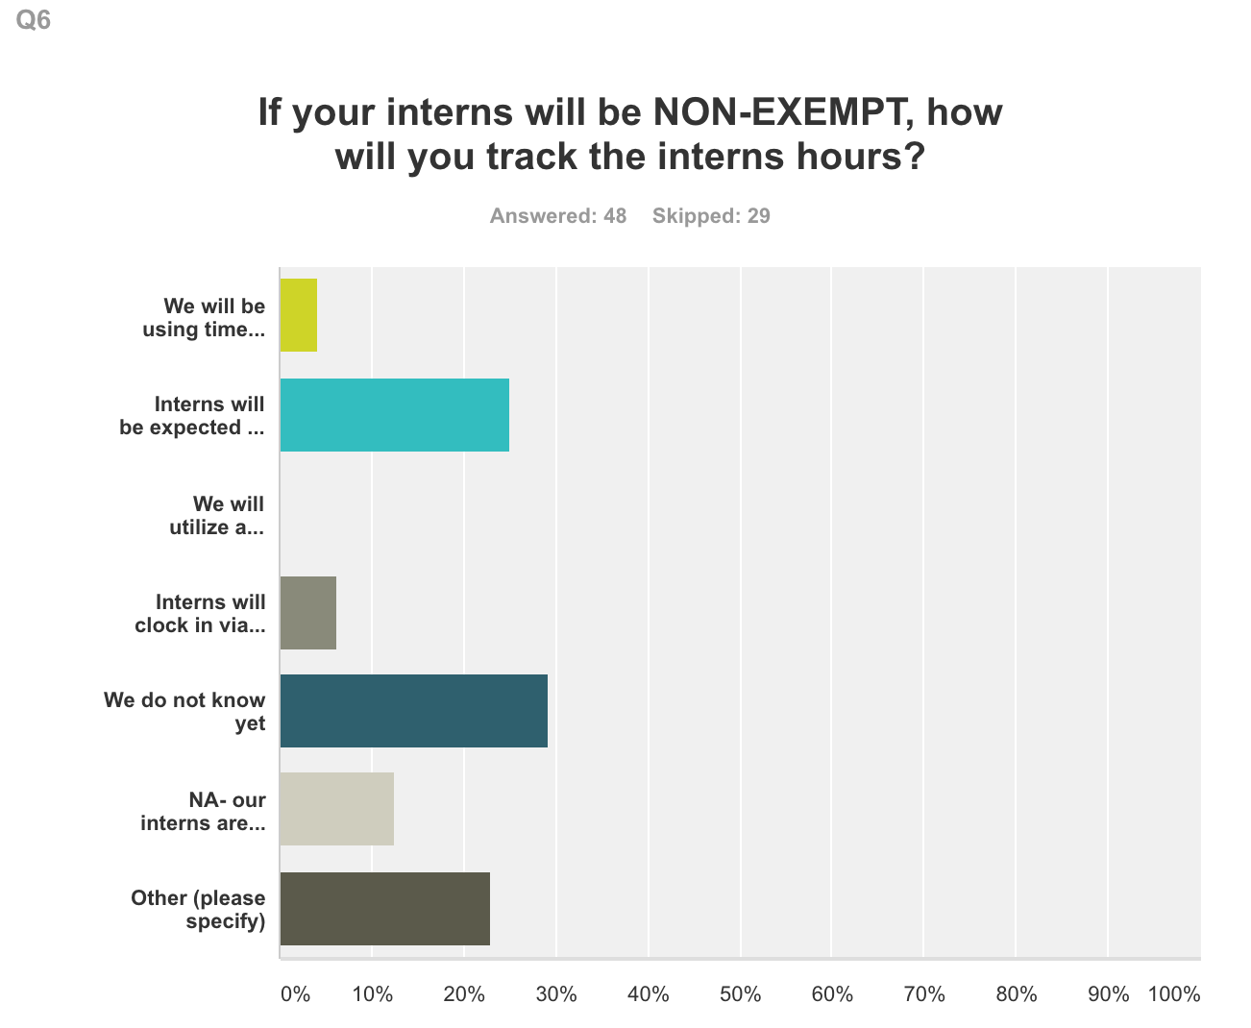
ACCTA SURVEY
We will be using time clocks to check in and out each day
Interns will be expected to keep track of their time and provide the information
We will utilize a modified version of Time to Track to accurately assess the hours they are in the office doing work related tasks
Interns will clock in via a webmail time clock
We do not know yet
NA-our interns are exempt
Other (Please specify)

Slide 37
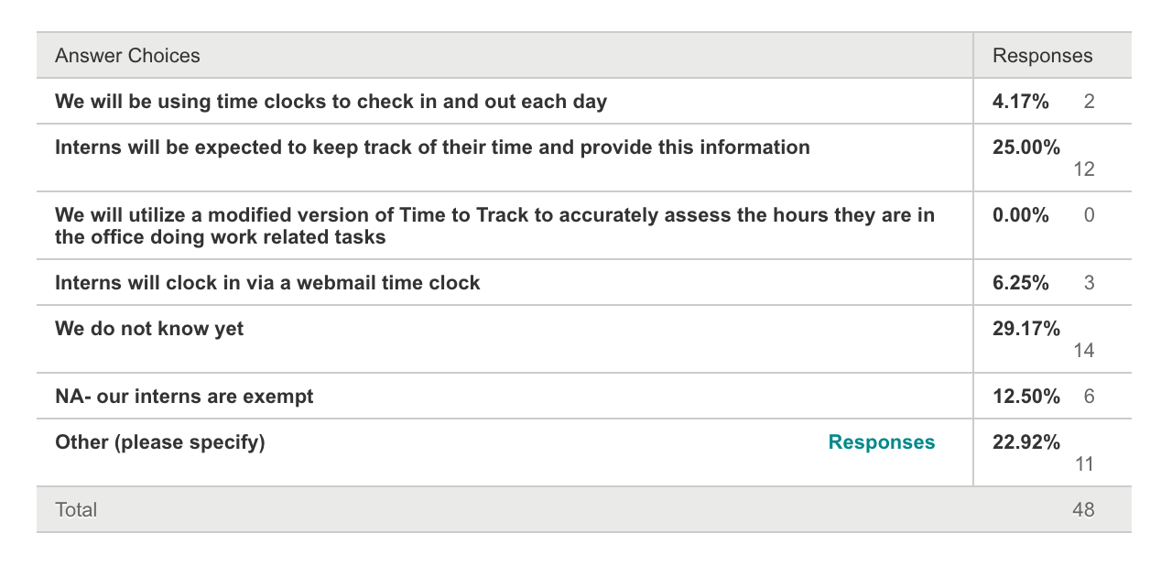
ACCTA SURVEY

Slide 38
ACCTA SURVEY
Other (please specify) Responses 22.92% 11
Keep them to 40 hours/week via flex scheduling
No decision yet made
HR is still determining process
Fill out HR timesheet at end of each day
Combination of titanium, TD oversight (we do not have a very good system and it’s very time consuming)
Our interns are hourly so clock in and out, plus we have them track their hours separately
We track intern hours through our electronic software. Point and Click
Interns hours are tracked from their schedules using our electronic record keeping system (Pyramed) with all “compensatory hours” tracked by one of our administrative staff
Titanium as well as biweekly time sheets (similar to staff)
n/a

Slide 39
ACCTA SURVEY
Q7. What will your center do if interns go over 40 hours in a given week?
Answered: 51
Skipped: 26

Slide 40
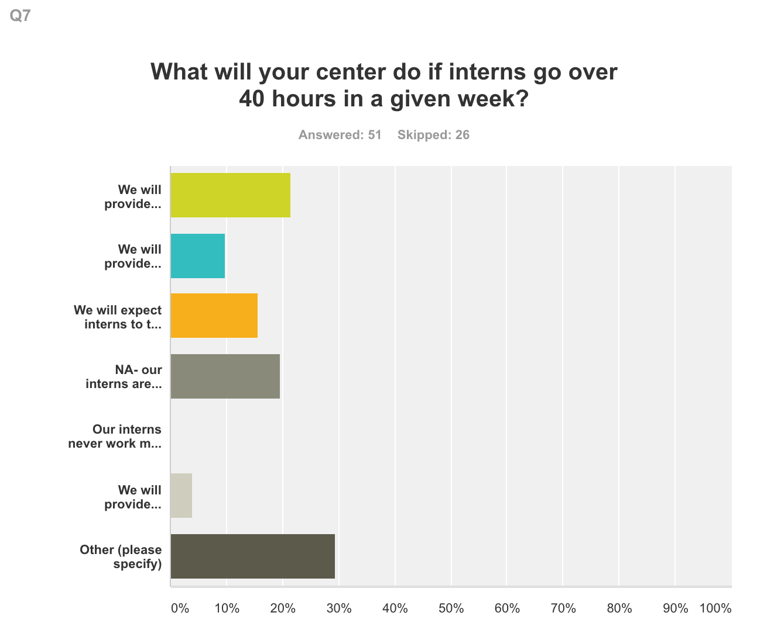
ACCTA SURVEY
We will provide overtime pay
We will provide overtime pay only for hours that were pre-authorized
We will expect interns to take compensatory time in the same week
NA – our interns are EXEMPT
Our interns never work more than 40 hours per week anyway
We will provide compensatory time at a rate of 1 and half time within the next 180 days
Other (Please specify)

Slide 41
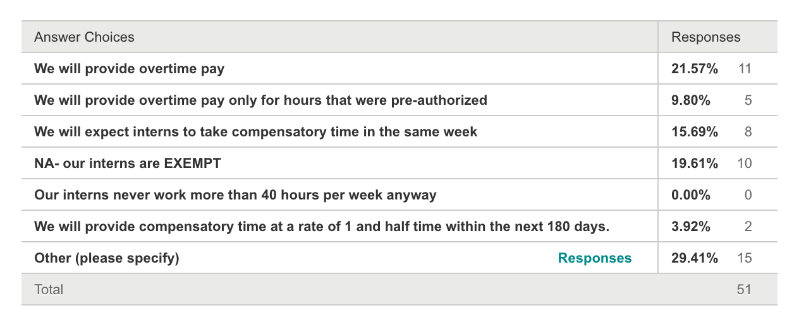
ACCTA SURVEY

Slide 42
ACCTA SURVEY
Other (please specify) Responses 29.41% 15
No decision yet made (3)
HR advised us to count the 2 hrs. of professional development leave we offer per week to interns, giving us a buffer of 2 hrs. a week before they accumulate 40 hrs. After 40 hrs., we plan to pay overtime only with prior request and approval.
Still to be determined – do know that we will have some overtime.
We are providing availability of overtime pay in lieu of a raise in salary. Interns will know about how much they can take per week if they do work overtime. We will adjust their schedules if they are unable to keep within budget.
We will ask interns to use their accumulated comp time prior to using vacation time and prior to ending the internship. If additional overtime hours can’t be used we will pay the interns the remaining balance.
Interns will get compensatory time to use at a later point.
My understanding is that interns will have a choice between receiving overtime pay or comp time.
Interns will be allowed to work up to 42 hours per week. If they go over that amount we will have to figure out how to decrease their work demands, hopefully without compromising direct contact hours.
They will be required to not go over 42.5 hours this year. Next year our hourly rate will calibrate to an expected 42.5 hour week.
We are going to provide a combination of comp pay at time and a half, and then overtime pay if they start accruing too much comp time. From my understanding, both of those need to be pre-approved by the TD and we have been told that we can approve the overtime as either pay or comp time.
I have advised them that it is not expected or encouraged for them to go over 40 hours a week. Any time will be considered voluntary on their part and unpaid.

Slide 43
ACCTA SURVEY
Q8. If your interns will be NON-EXEMPT, how concerned are you with the interns being able to satisfy the following internship requirements?
Answered: 43
Skipped: 34

Slide 44
ACCTA SURVEY
Total number of hours required for our program
Number of direct face to face hours required for our program
Achieving the designated level of competency in each competency area
Developing an appropriate sense of professionalism

Slide 45
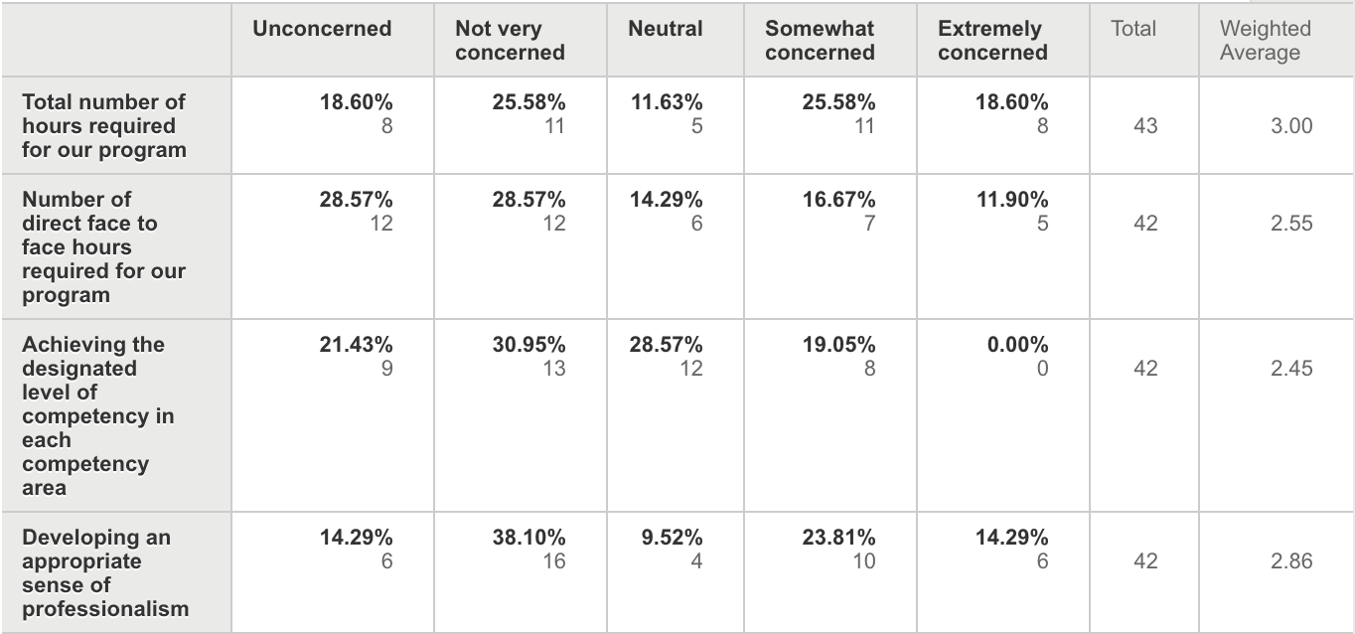
ACCTA SURVEY

Slide 46
ACCTA SURVEY
Q9. If you have developed a plan for your interns who will be NON-EXEMPT, what problems or concerns do you anticipate in implementing the plan you have developed?
Answered: 25
Skipped: 52

Slide 47
ACCTA SURVEY
Audience participation

Slide 48
ACCTA SURVEY
Q10. Are there additional thoughts or concerns that you have regarding FLSA and your internship program?
Answered: 26
Skipped: 51

Slide 49
ACCTA SURVEY
Audience participation

