Slide 1
Starting an Internship from Scratch: A Recipe for Success
Amber R. Cargill, Psy.D.
George Washington University
Emily Russell Slife, Ph.D.
University of Nevada-Las Vegas
Notes:
Presentation Description: This presentation will provide necessary "ingredients" for creating a successful internship program from scratch. Hear about trials and triumphs from two training directors who just completed their first year of new internship programs. Reflections, guidance, and resources will be provided in order to minimize challenges when implementing a new internship program. We will discuss the process of creating a psychology internship in a university counseling center setting and provide detailed information on training needs, tasks, and the role of a training director in a university counseling center. We will address time lines, budgets, and important tips to help make the process a success. We will provide information on applying for APPIC membership, participating in the internship match as non-APPIC members, and the process of writing an initial self-study in an effort to obtain APA accreditation. If applicable, we will also complete an activity with participants in order for them to start an action plan specific for their internship program needs.

Slide 2
Learning Objectives
Prepare for the process of creating a psychology internship, from the initial stages through recruitment
Compile information on the ingredients necessary to implement the internship successfully
Gain understanding of diversity as key ingredient to a successful internship (e.g., recruitment and retention of staff/interns, multicultural competence training), and the variety of ways to satisfy the requirements of Domain D (individual and cultural differences)
Review timelines and task lists in order to become familiar with the training director's responsibilities
Create a plan of action for your center's training needs
Notes:
This presentation will provide necessary “ingredients” for creating a successful internship program from scratch. Hear about trials and triumphs from two training directors who have completed their second year of new internship programs. Both training directors are in various stages of the application for initial accreditation process (i.e., site visit completed, self-study submitted). Reflections, guidance, and resources will be provided in order to minimize challenges when implementing a new internship program. We will discuss the process of creating a psychology internship in a university counseling center setting and provide detailed information on training needs, tasks, and the role of a training director in a university counseling center. We will address time lines, budgets, and important tips to help make the process a success. We will provide information on applying for APPIC membership, participating in the internship match as non-APPIC members, and the process of writing an initial self-study in an effort to obtain APA accreditation. We will discuss the importance of infusing individual and cultural difference into the internship program. If applicable, we will also complete an activity with participants in order for them to start an action plan specific for their internship program needs.

Slide 3
Increase Internship Positions
The 2016 Match was the most successful in years
94% (3,595) of applicants matched in Phase I or Phase II
Only 219 applicants were not matched
Some of the 219 matched in the Post-Match Vacancy Service
Despite these improvements, there is still a need for more ACCREDITED internships
Provides a range of options
Need internships in rural and areas without many training programs to offer choices within proximity to applicants
Notes:
In 2018, individuals from non-accredited programs will not be able to participate in the match

Slide 4
Our experiences
1st ACCTA conference September 2013
First Match Process February-March 2014
First interns on-site in August 2014
Both have two interns
Notes:
Share our experiences- next two slides
Emily/Amber discuss their schools, centers, special populations served. Any particular needs of center (e.g., GW has a lot of int’l students and crisis intervention).
Emily/Amber share their experiences with ACCTA
Emily/Amber discuss APPIC application
Emily discusses match (including Phase II and post-match)
Emily/Amber discuss grant
Amber discusses self-study

Slide 5
Amber’s Timeline
Summer 2013 Enrolled in Match as Non-member
February 2014 First Match
October 2014 APPIC Member-ship
December 2014 BEA Grant Awarded
September 2015 Submitted Self-Study
October 2015 Approved for Winter Cycle Site Visit
March 2016 Site Visit
May/June 2016 Site Visit Report & Response
August 2016 APA Accredita-tion!
Notes:
GWU planned to revive training program, and began so in 2012 with the addition of postdoctoral fellows
2013: Became Training Director
2013: Enrolled in APPIC match as non-member
2014: Matched both internship slots in Phase I
2014: Obtained APPIC membership in early October
Participated in 2015-2016 match as APPIC member
Received BEA grant in December
2015: Submitted initial APA self-study in September

Slide 6
Emily’s Timeline
Summer 2013 Enrolled in Match as Non-member
March 2014 Matched in Phase II
May 2015 Obtained APPIC Membership
May 2015 BEA Grant Awarded
April 2016 Submitted Self-Study
July 2016 Approved for Fall Cycle Site Visit
November 2016 Site Visit
Notes:
UNLV CAPS planned to start an internship years ago. The office space was built in 2007 with 4 intern offices. Due to the recession, this plan was tabled.
Started with a postdoc in 2010 instead, did this for 4 years
2012: Became Training Coordinator
2013: Participated in APPIC match as non-member
2014: Started internship program (2 interns)
Participated in match as non-member again
2015: Obtained APPIC membership
Received BEA grant
2016: Submitted the self-study on April 29, the last cycle under CoA
July 13: Informed we’d been approved for a fall site visit, which is scheduled for November 7 and 8.

Slide 7
The Recipe
Learning Objective #1

Slide 8
So you want to have an official internship program...
Before you get started, you will need to do and/or think about the following:
Understanding your center
What type of experience do you envision for your future interns?
What “ingredients” are necessary to have early on?
What are the steps I need to take?
Notes:
Discuss support for internship
Discuss crisis intervention; high int’l student pop; large veteran student pop
Discuss conceptualizing ways to ensure sequential and cumulative nature of internship
Understanding your center
Support for internship
Where would your interns fit in within your center’s culture?
Are there special populations served that make your site unique?
What dynamics within your center and/or university may impact your interns?
What type of experience do you envision for your future interns?
Sequential, cumulative, and graded in complexity
Seminars (amount and content)
Supervision experiences
Rotations/Concentrations
What “ingredients” are necessary to have early on?
Goals, objectives, competencies (more on this later)
Evaluations, evaluations, evaluations
Didactic ideas
Sample schedule
What are the steps…
APPIC, BEA Grant, Self-Study recommended in that order

Slide 9
APPIC
Association of Psychology Postdoctoral and Internship Centers
Can start an internship program before membership
Participate in the match as a non-member
Cannot apply for membership until interns are physically on site (minimum of 2 interns)
Policies
Grievance procedures
Supervision requirements
Training director requirements
Brochure
Notes:
Suggested timeline--be ready to submit your APPIC application the day your interns arrive!!!! Timeline for approval (meeting appropriate deadlines) is around 2 months. Submitted August 25th (before Sept 1 deadline) heard back by Oct 9th to make edits, final decision by Oct 24th.
Emily submitted March 26 (prior to April 1 deadline), heard back May 4 that it was moving forward for board approval, final decision received May 15th.
Programs available through APPIC
WICHE Accreditation Assistance project (not for new members- Emily will only be part of if they continue the program for another year)
Grievance procedures—Consult with EEO/HR/OGC!! Discuss pushback from university and resolution.

Slide 10
BEA Grant
APA Grant for Internship Programs
Provides seed money to pursue APA Accreditation
-APA Accreditation Application Fee $2,250
-APA Accreditation Site Visit Fee $3,400
-Consultant/materials/clinical release time
Notes:
2012: 3 year, $3 million internship stimulus package to increase number of internships (530 slots projected)
Amber and Emily suggest proceeding in this order-- APPIC first, then grant, as much of what you will need to apply for the grant has been completed through the APPIC membership process

Slide 11
APA Self-Study Process
Time
Are you a slow and steady person?
Take 9-12 months start to finish to write the study with 4-8 hours per week dedicated to writing.
Are you someone who works best under a stricter time constraint?
Take 6-8 months start to finish to write the study with 1-2 days per week dedicated to writing.
Reality is that life will happen***
Structure
Domains A-H (**B and F**)
Text, Tables, and Appendices
Notes:
Amber’s timeline--after receiving word of the grant, and enrollment in accreditation project, began self-study in January
Discuss WICHE Accreditation Assistance Program through APPIC
Discuss planning out order of operations (Starting with Domain A isn’t necessarily the best way to start)
Discuss attending APA self-study workshop at ACCTA
Discuss ACCTA resources
The program you have now, may not be the program you propose to APA--be sure that you are implementing the adjustments you are proposing

Slide 12
APA Self-Study Process
Content Buzzwords
Goals, Objectives, Competencies
Goal—Overarching outcomes for your program
Objective—How will you accomplish your goal?
Competency—What will the intern do to demonstrate achievement toward goal and objective?
Proximal vs. Distal Data
Proximal—How well your interns progressed through program
Distal—Did your program do what it intended? (post-internship)
Cumulative, Sequential, and Graded in Complexity
DIVERSITY AKA Individual and Cultural Difference
Notes:
Amber’s timeline--after receiving word of the grant, and enrollment in accreditation project, began self-study in January
Discuss WICHE Accreditation Assistance Program through APPIC
Discuss planning out order of operations (Starting with Domain A isn’t necessarily the best way to start)
Discuss attending APA self-study workshop at ACCTA
Discuss ACCTA resources
The program you have now, may not be the program you propose to APA--be sure that you are implementing the adjustments you are proposing

Slide 13
Goals
Evaluations

Slide 14
APA Self-Study Process
Deadlines
Applicant programs can submit on a “rolling basis”
Review meetings held twice per year (October/April)
Contact the Office of Program Consultation and Accreditation for more information (202) 336-5979
Consultant
Editing
Conceptualization
Processing
Accreditation
Full vs. On Contingency

Slide 15
APA Self-Study Process
What I wish I would have asked…
So what is the process like?
Painful ☺, exciting, arduous, creative, intriguing, inspiring
Deconstructing/Reconstructing/Revising
Reviewing EVERYTHING that you do with your interns
Can/Should others help?
Yes, but…
Depends on you and your program, and what they help with
What should I do to get started?
Compile everything that you do with your interns now
Gather all documents related to your program (EVERYTHING)

Slide 16
What happens next?
Once your program is reviewed, two options:
Defer for info
Approved for site visit
Once approved for site visit
SELECT COMMITTEE FIRST
Respond to the preliminary review report
Prepare for site visit

Slide 17
What happens next?
After the site visit
Receive site visit report after ~30 days
Respond to site visit report within 30 days of receipt
Wait, wait, wait
Two possible outcomes
You’re Accredited
Defer for info
Initial applicants have the opportunity for a defer for info first, and cannot be outright denied at this point

Slide 18
Site Visit 101
Select your chair first!
Prioritize ACCTA members, then counseling center staff, then others
\Be flexible with your date (this is a negotiation process)
Ask your chair about whether they’ve worked with members from your list of second visitors
You may need to go through more than one list
Select your second visitor
Prioritize in the same order
Confirm with chair your second member, and put in touch with one another
Now you have your committee and date

Slide 19
Site Visit 101
Send your committee options for lodging and transportation
Offer your recommendations
Ask about any specific accommodations committee may need (e.g., food restrictions, mobility issues)
Plan for Day 1 to be 9-10 hrs; Day 2 about 6-7
Ask about handling lunch on both days
The second day’s lunch will likely be a working lunch
Complete your preliminary review report and send to site visitors and APA at least 6 weeks before site visit\
Include any changes that have occurred since self-study

Slide 20
Site Visit 101
Create your schedule
Use ACCTA resources for templates (ask for examples)
Essential people meetings
You
Current Interns
Former Interns
Supervisors and/or staff
Center Leadership
Think about individuals/offices that interact with the interns
Campus partners
Front desk
Other trainees
Show support for the program
Divisional leadership
Home program DCT
Notes:
Amber pull up your schedule

Slide 21
Site Visit 101
Records Review (a test of your organization skills)
Working Lunch
A review of all documentation for interns
Evaluations
Documentation from home program
HR paperwork
Timesheets
Applications
Match letters
Client documentation
Certificates
Assessment reports
Outreach powerpoints
Anything that exemplifies their work
Notes:
Client documentation can mean printing notes. Doesn’t need to be that they have access to Ti. This isn’t review of their client records, rather, ct records are one part of this process

Slide 22
Site Visit 101
Prep your participants
Make sure they ALL know…
Your training model
Your goals
Their names ☺
Make sure supervisors know
Evaluation procedures
Make sure the director knows
How to communicate stability of internship
Make sure you know
All of the above
The answers to the preliminary report

Slide 23
Site Visit 101
Do
Take the time to prep each group independently. The goal of the meeting with the site visitors is different depending on the group.
Provide guidance on how to answer general questions and those specific to your site
Develop a pneumonic device for your training goals
Plan to pick up site visitors
Plan to relax during the visit. There may actually not be much for you to do
Make life easy for site visitors (name tents help)\
Plan the feedback session when all staff can attend

Slide 24
The Ingredients
Learning Objective #2

Slide 25
Now that you’ve done your preparation…
Ingredients
Use ACCTA resources
Attend the conference ☺
Talk to TDs who are where you are in your process
Ask for actual resources (DO NOT BE AFRAID TO ASK! WE WANT TO HELP!!)
Sign up for an ACCTA mentor
Sign up for an APPIC mentor
Attend the APA self-study program at ACCTA conference
Psychology Internship Development Toolkit
Notes:
ACCTA and APPIC websites have examples of self-studies
Toolkit is a PDF document online

Slide 26
Now that you’ve done your preparation…
Ingredients cont’d
Support from Director and staff
Allotted Budget
Organization
Attention to details
Flexibility
The main ingredient…TIME!
Notes:
Discuss realistic timelines, including getting tasks accomplished during slow periods

Slide 27
Domain “D”iversity
Learning Objective #3

Slide 28
A Key Ingredient
Individual & Cultural Difference (Domain D)
Implement into every aspect of training program
Seminars, evaluations, staff meetings, office space
Focus on your center and program’s strengths and use this throughout internship
Region, student enrollment
Preparing interns to serve diverse populations
Multicultural Seminar
Statement on serving diverse others
Statement on serving diverse others
Don’t be alarmed if you are asked to discuss this further at several points in the process
Notes:
Examples from UNLV (tied for 2nd most diverse college campus in the country, minority serving institution, staff meeting multicultural moments, etc) and GWU high int’l student population
Recruitment
Sending to multiculti listservs
Website advertisement encouraging applicants from diverse backgrounds to apply
Commitment to diversity via website
Teaching diversity
Incorporated into all seminars
Specific diversity seminar
Diversity emphasis--E.G., students of color walk-in hours, Let’s Talk, diversity committee, types of clients served

Slide 29
Timelines & Flow
Learning Objective #4

Slide 30
Learning Objective #4
Review timelines and task lists in order to become familiar with training director responsibilities
Once the internship has started, here is a list of tasks that need to be completed
Monthly task list hand out
The “flow” of the training year
Notes:
Review timelines and task lists in order to become familiar with training director responsibilities
We could tie this back to APPIC membership, because through that process you begin to start compiling what you need to do.
Make sure orientation procedure is outlined clearly.
Talk a little about how our programs are structured (e.g., trainings, supervision, training committee, etc) because in theory the folks in ours are going to be ppl who, like us the first time, haven't done this yet. That can be a supplement for the fixed task list. Thoughts?

Slide 31
Let’s Get Cooking!
Learning Objective #5

Slide 32
Learning Objective #5
Create a plan of action for your center’s training needs and goals.
Small group discussion (10-15 minutes)
Where are you at in the process of creating an internship?
Where is a good starting place to achieve your initial goals?
What are potential blocks to get started?
What resources do you need to achieve your goals?
Based on what you’ve learned today, what does a realistic timeline look like for you?

Slide 33
Contact Us
Amber’s Info
ambercargill@gwu.edu
202.994.5262
Emily’s Info
Emily.RussellSlife@unlv.edu

Slide 34
References
American Psychological Association (2014). APA applauds narrowing of psychology internship gap.
Retrieved from http://www.apa.org/news/press/releases/2014/02/internship-gap.aspx
Campbell, C. D., Emmons, L., Mangione, L., Grus, C. L., Berry, S., Dailey, K. C., Smith Hutchings, P.,
Nutt, R. L., & Siegel, W. G. (2015). Using the psychology internship toolkit to increase the number of internship positions. Training and Education in Professional Psychology, 9, 195-201.
McCutcheon, S. R. (2011). The internship crisis: An uncommon urgency to build a common
solution. Training and Education in Professional Psychology, 5, 144-148.
Meyerson, D. A., Meyerson, L. N., Bolson, A., & Wilson, G. A. (2013). A legal “case” against the
internship placement system and a proposal to fix the system and the internship imbalance. Training and Education in Professional Psychology, 7, 174-184.
Wells, S. R., Becker Herbst, R., Parent, M. C., Ameen, E. J., Hassan El-Ghoroury, N., Mattu, A. M.,
Wilson, G. A., Mereish, E. H., & FitzGerald, M. E. (2014). The internship crisis: Graduate students look back and plan ahead. Training and Education in Professional Psychology, 8, 112-118.

Slide 35
Conclusion
Questions?
Thank you!

Slide 36
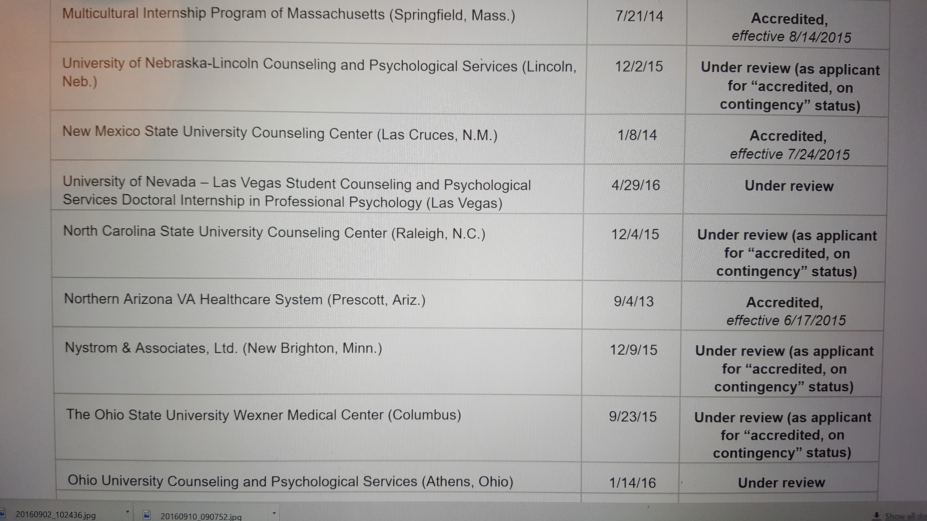
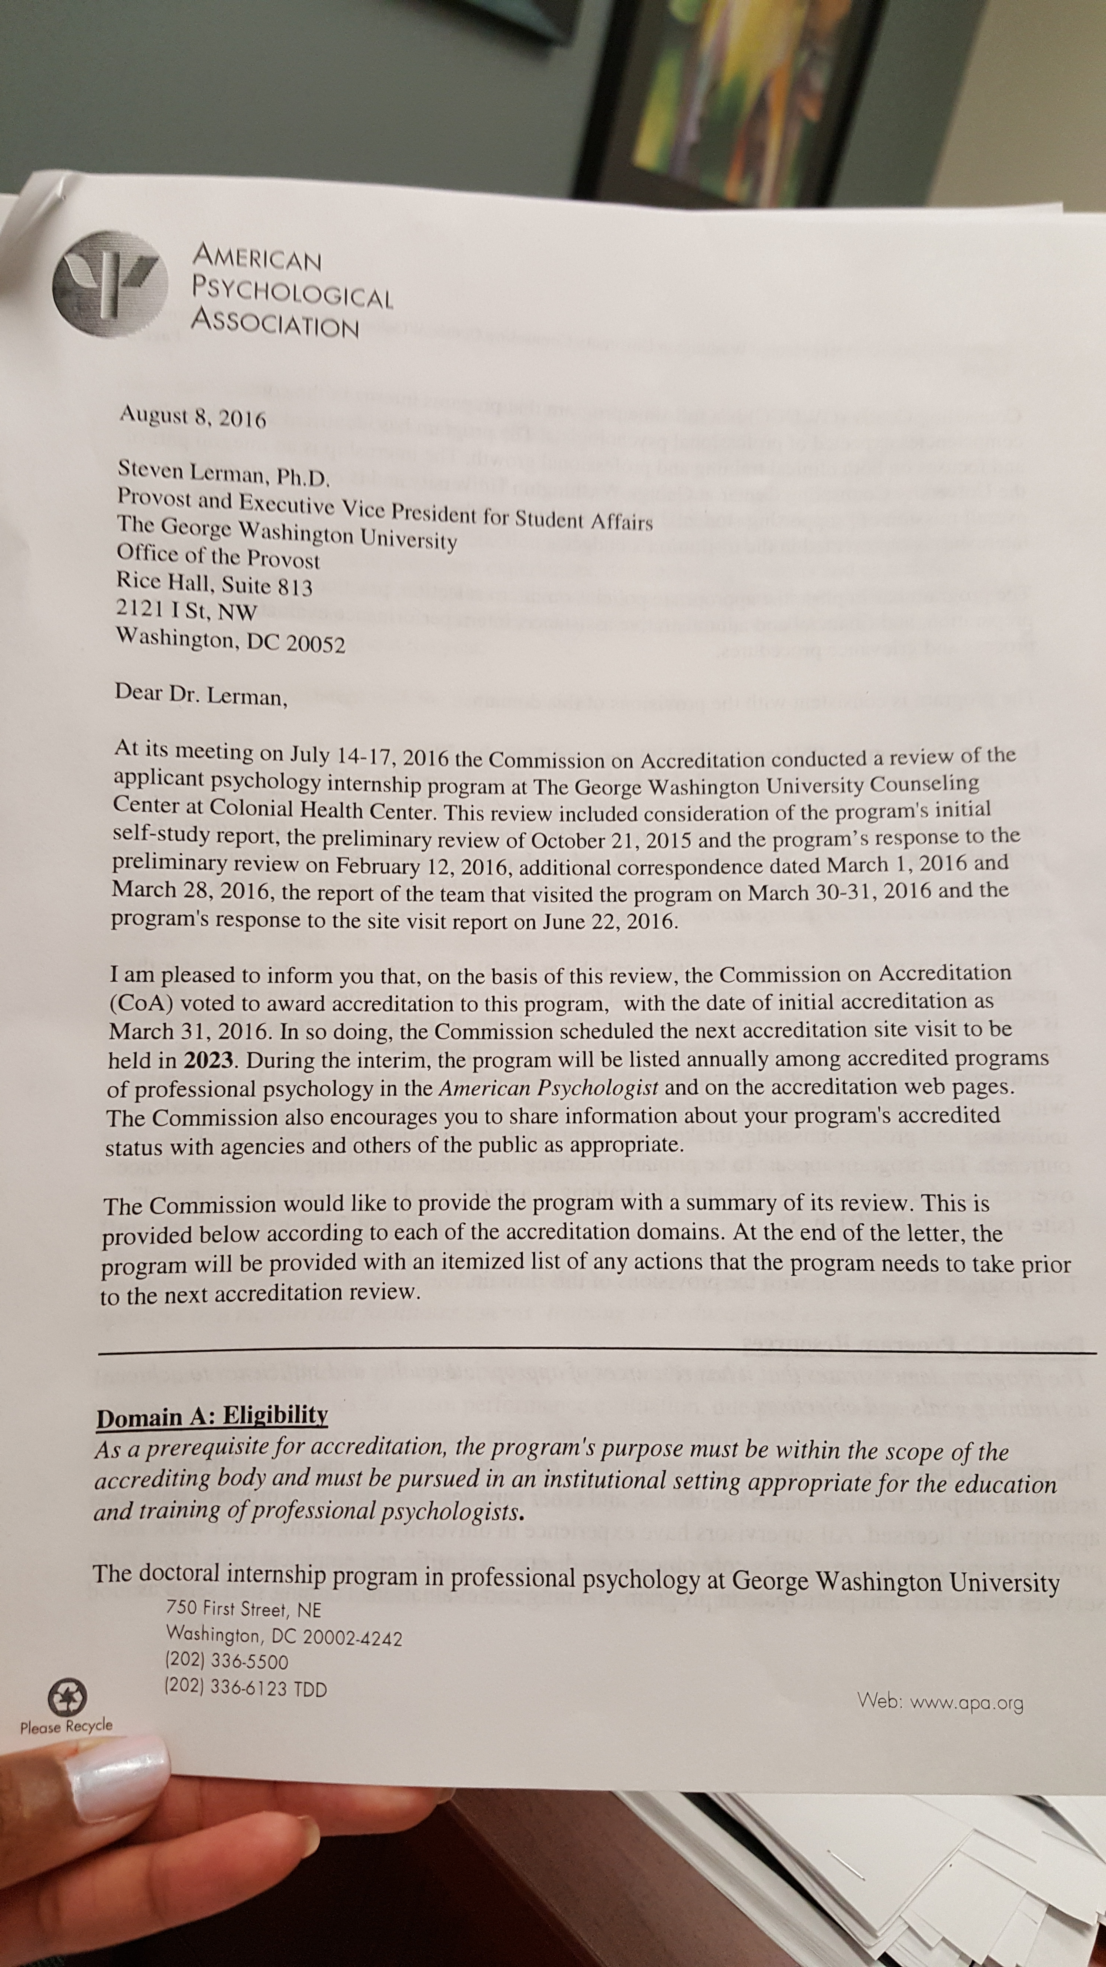
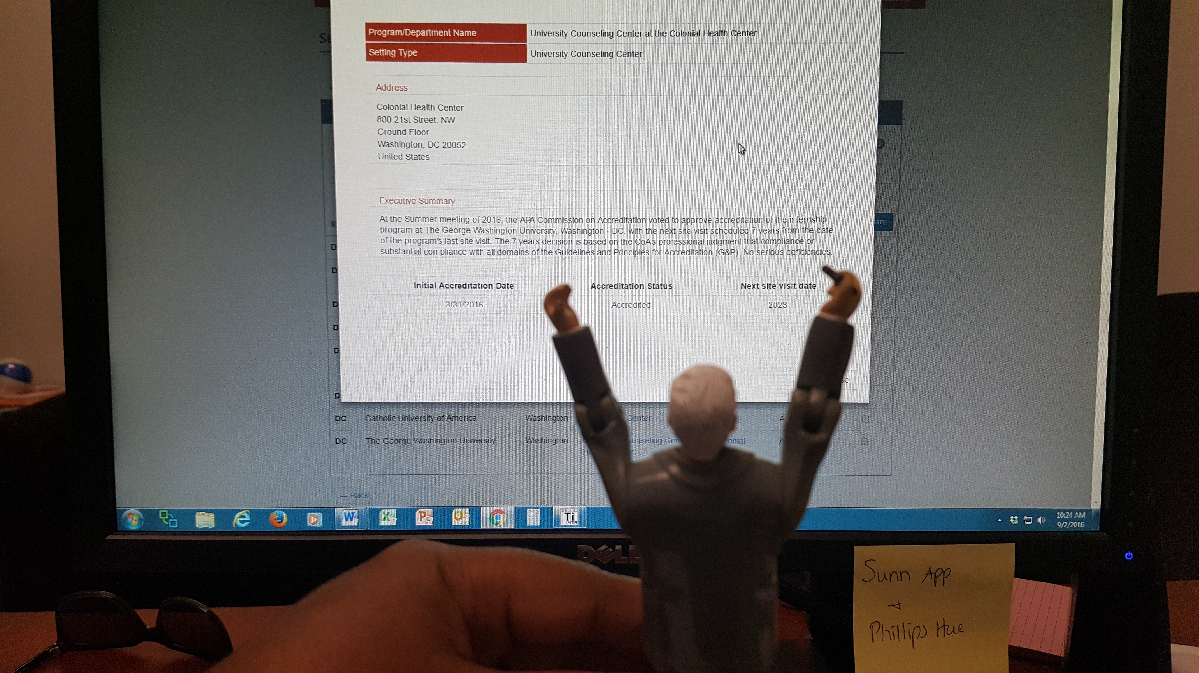
YOU CAN DO IT!!

